Slide 1
Effects of Input Nuclear Physics on Core Collapse Supernova Simulations
Brandon Barker¹, Theo Cooper², Mike Pajkos³, Jenn Ranta³, MacKenzie Warren³ ,Sean Couch³
¹University of Tennessee, ²Johns Hopkins University, ³Michigan State University
ACRES Final Presentation July 25, 2018

Slide 2
Supernova?
Spectacular explosion that accompanies the death of a massive star
Scientific American
Baby Star
Old Star
Supernova
ACRES Final Presentation July 25, 2018

Slide 3
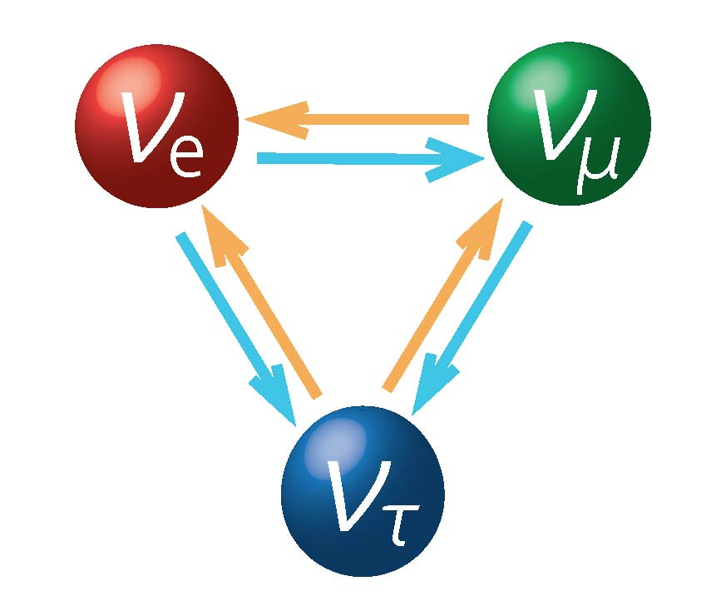
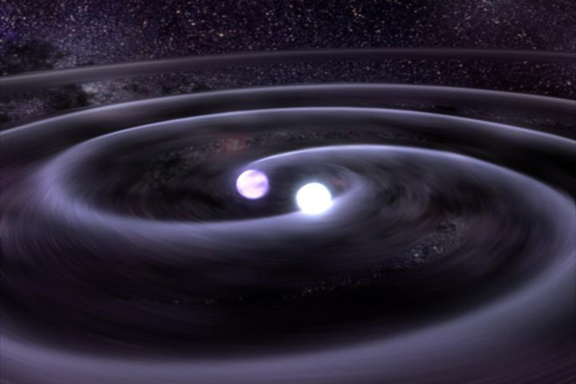
Why Study Supernovae?
Excellent laboratories for nuclear physics
Produce heavy elements
Galactic evolution
Understand neutron star and black hole mass distributions
Important for neutron star mergers
Source of neutrinos, gravitational waves
ACRES Final Presentation July 25, 2018

Slide 4
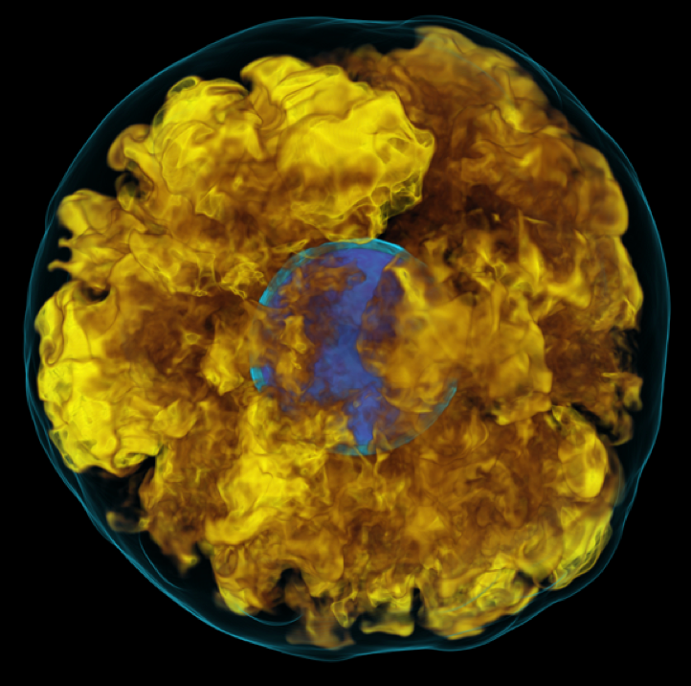
Supernovae - A Complex Problem
Core Collapse Supernovae (CCSNe) include all physics
Uncertain Nuclear Physics
Magnetohydrodynamics
General Relativity
Neutrino transport
All very difficult to simulate!
Numerous approximations necessary
ACRES Final Presentation July 25, 2018

Slide 5
Uncertainties in Nuclear Physics
Our knowledge of nuclear physics is far from complete
The environments present in CCSN differ greatly from those in terrestrial experiments
A gap in our knowledge:
Equations of State (EOS) must be extrapolated down to the regimes necessary for CCSNe
Many ways to do this - the method will affect the outcome of the simulation!
Explosion?
Nuclear Physics
NS Mass Distribution?
Neutrinos? Optical? GW?
ACRES Final Presentation July 25, 2018

Slide 6
What We Did
138 progenitor stars
9 Equations of state
1,242 simulations to compare
1
2
3

Slide 7
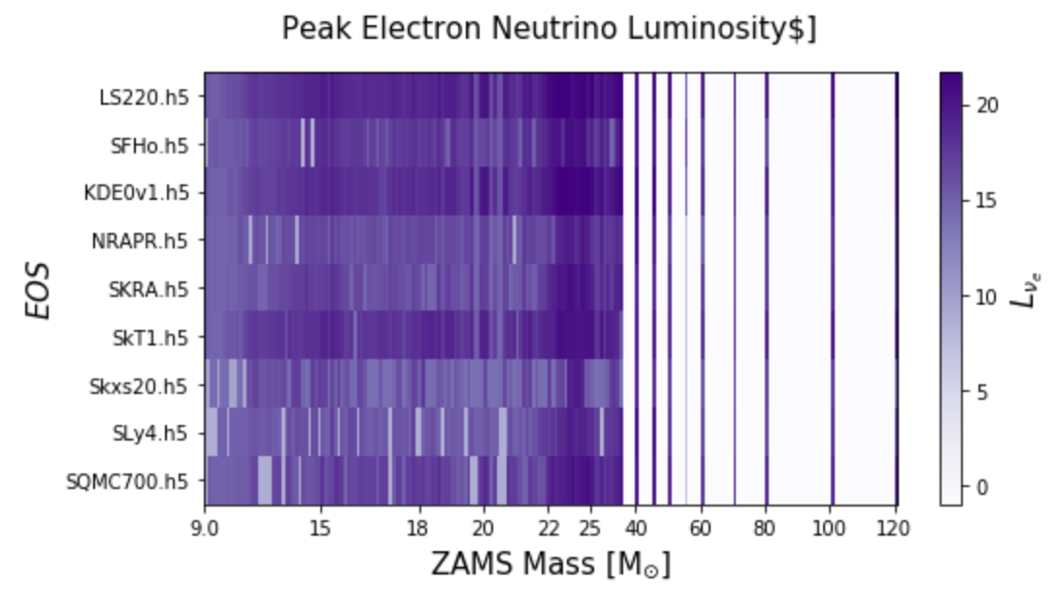
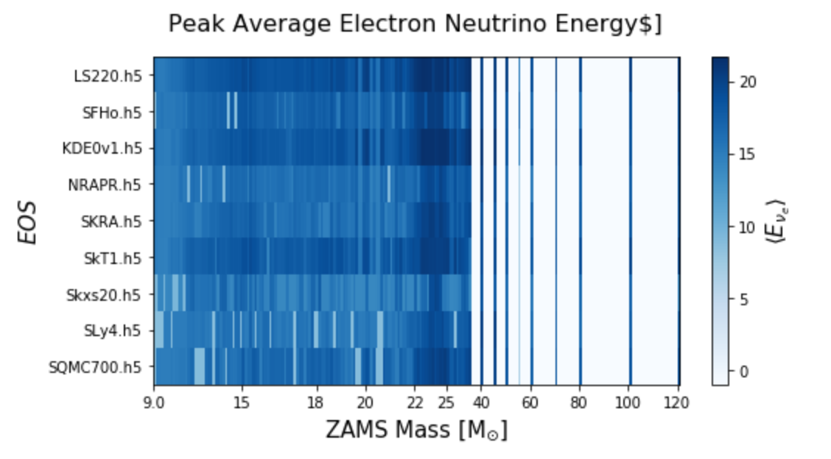
Neutrino Emission
ACRES Final Presentation July 25, 2018

Slide 8
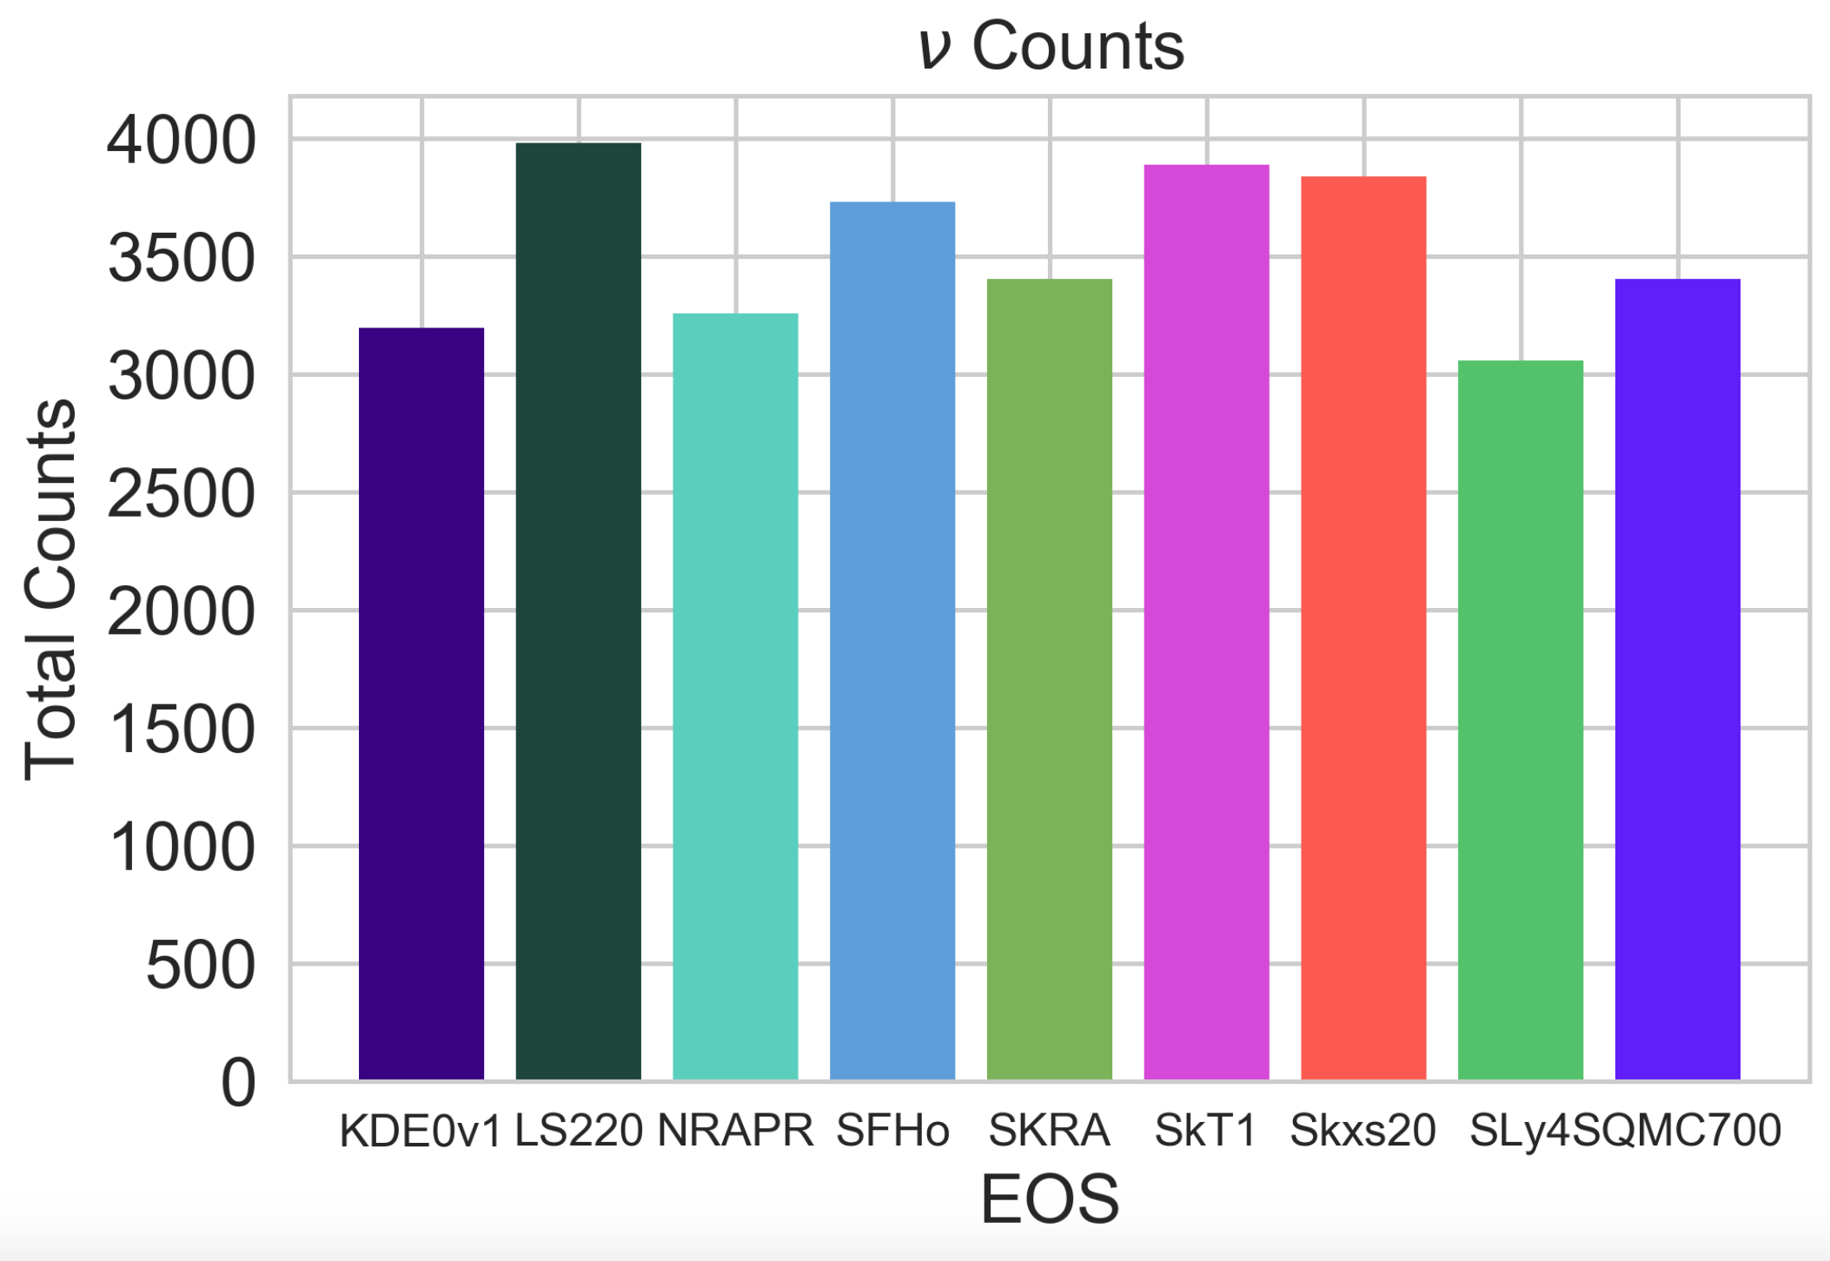
Neutrino Detection
ACRES Final Presentation July 25, 2018

Slide 9
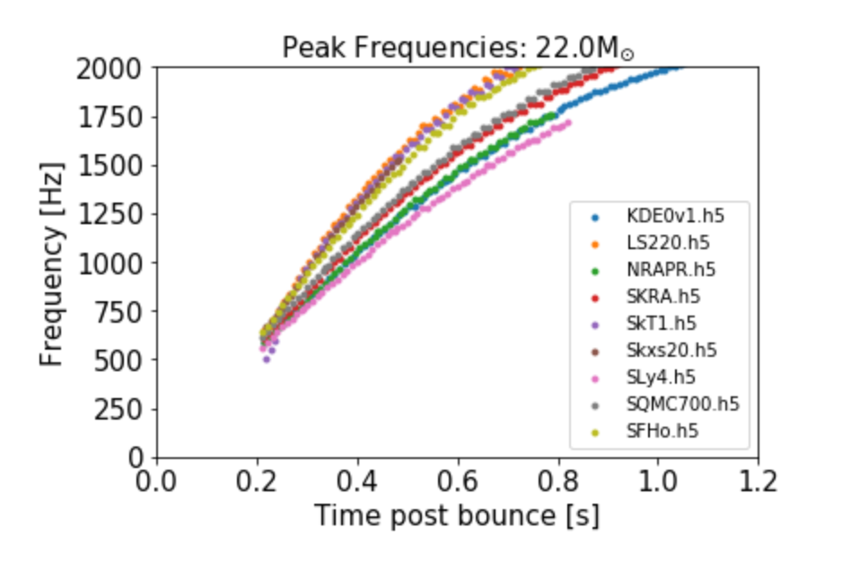
Gravitational Waves
ACRES Final Presentation July 25, 2018

Slide 10
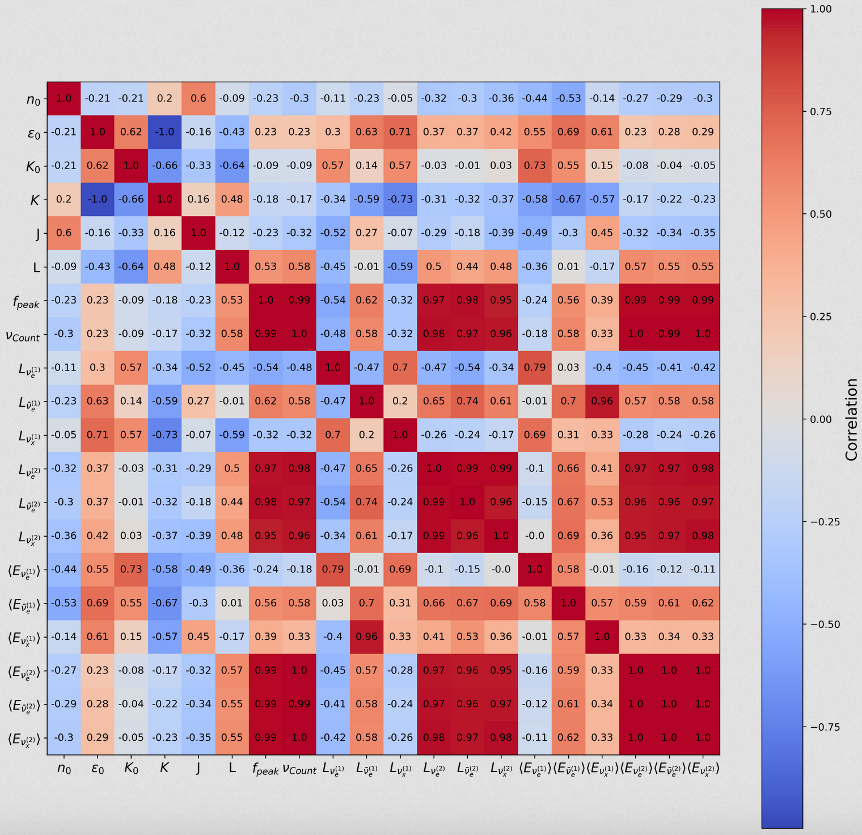
The Big Plot
ACRES Final Presentation July 25, 2018

Slide 11
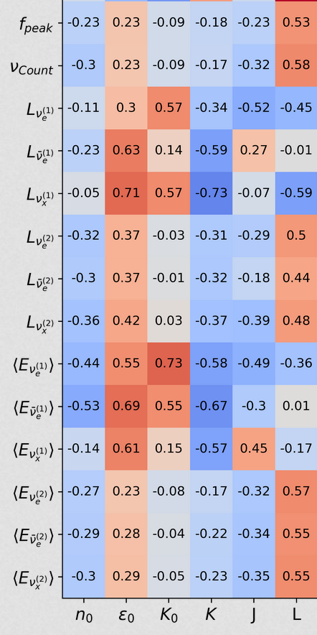
The Big Plot
ACRES Final Presentation July 25, 2018

Slide 12
Moving Forward
Run simulations further
Implement results from Theo’s work
Get optical detection information
ACRES Final Presentation July 25, 2018

Slide 13
Acknowledgements
Schneider, A., Roberts, L., and Ott, C. 2017
Kate Scholberg. Supernova neutrino detection. _Ann. Rev. Nuclear and Particle Science,_ 62:81, 2012.
Couch. The Royal Society. 2017.
A special thanks to Mike Pajkos, Jenn Ranta, MacKenzie Warren, Sean Couch, and the rest of the SNAPhU group.
ACRES Final Presentation July 25, 2018

Slide 14
Questions?
ACRES Final Presentation July 25, 2018

