Slide 1
Fitting turbulent and convective parameters in 1D core-collapse supernova simulations
July 25, 2018
Theo Cooper
Research Mentor: Dr. Sean Couch
Additional thanks to Dr. Mackenzie Warren, Michael Pajkos, Jennifer Ranta,
and Dr. Brian O’Shea

Slide 2
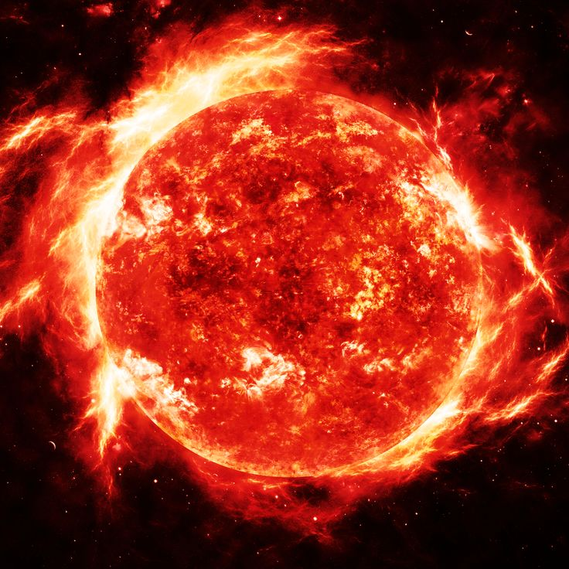
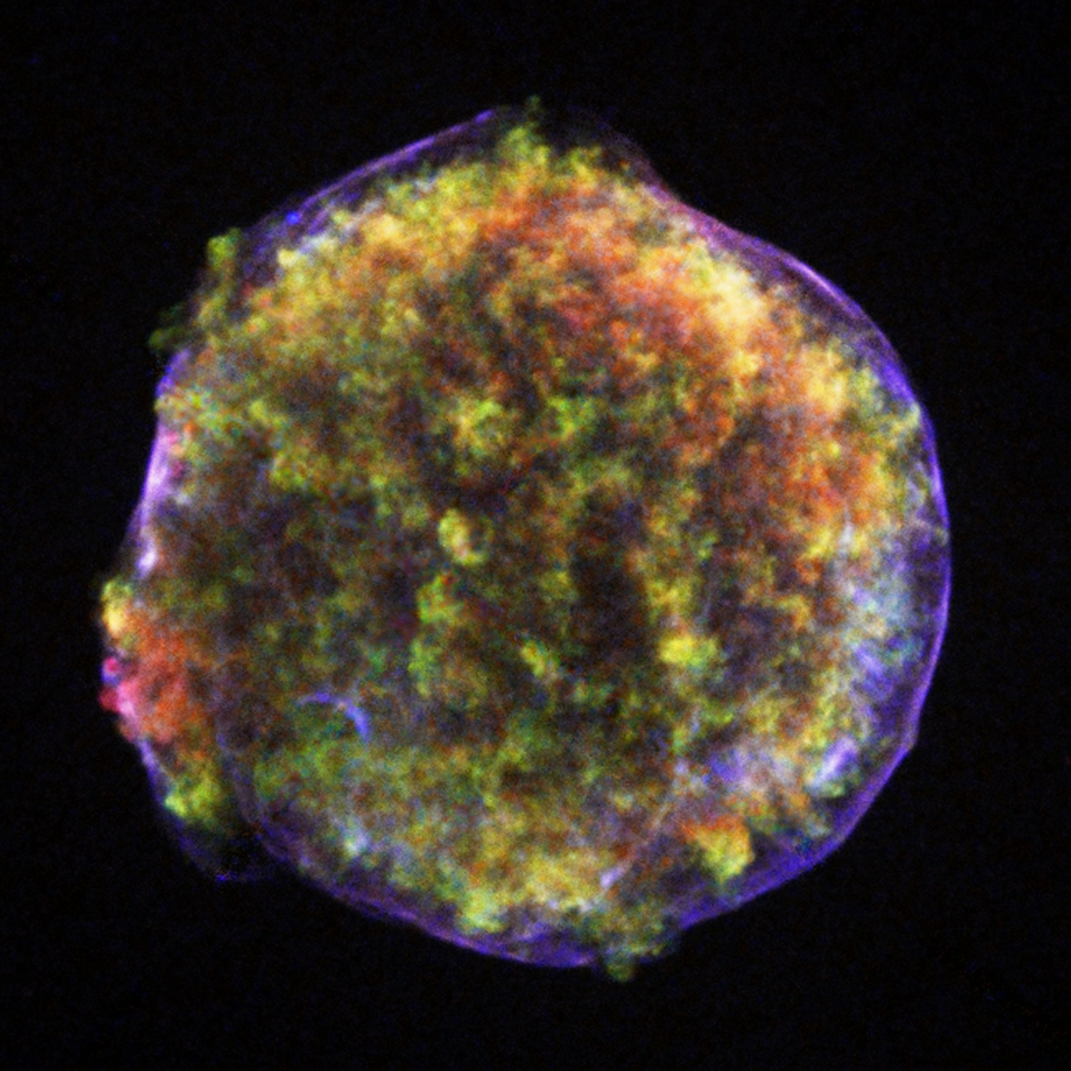
Background
Notes:
More background

Slide 3
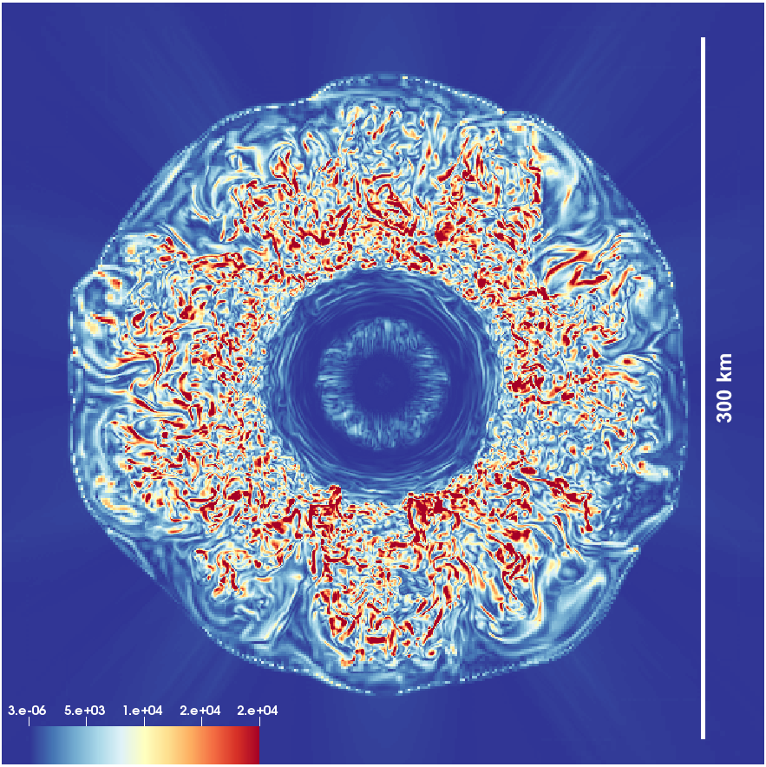
3D and 1D simulations

Slide 4
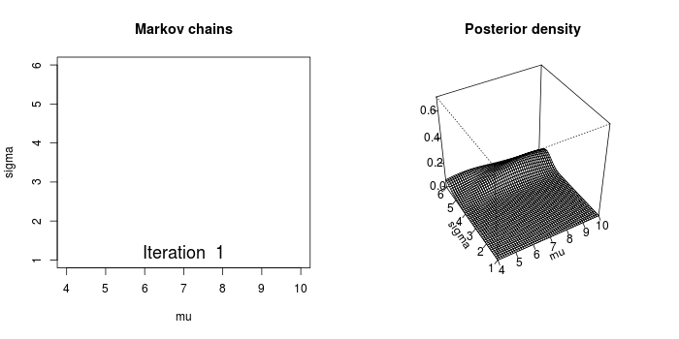
Markov Chain Monte Carlo
Source: http://revolution-computing.typepad.com/.a/6a010534b1db25970b019aff4a7bbc970d-pi

Slide 5
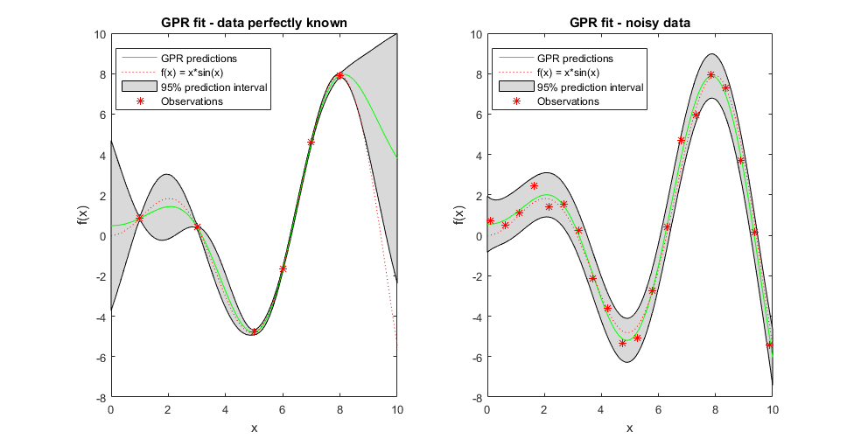
Gaussian Process Emulator
Source: https://www.mathworks.com/help/stats/gaussian-process-regression-models.html

Slide 6
Assumptions
α_{Λ} α_{D}
α_{D, turbulent Energy}
α_{Λ}
α_{D, neutrinos}
α_{D, electron fraction}
α_{D, internal Energy}

Slide 7
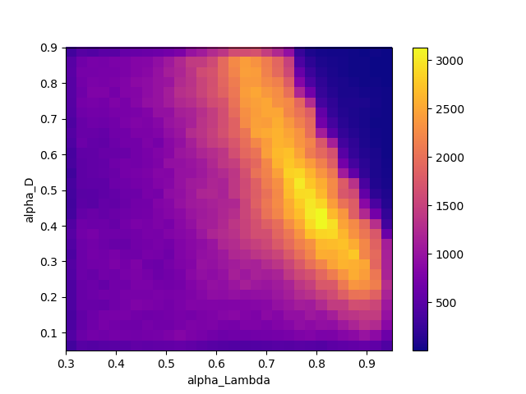
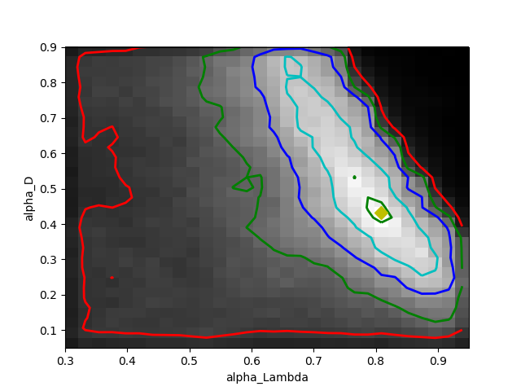
Results of 2-parameter trial
2D histograms of the parameter space

Slide 8
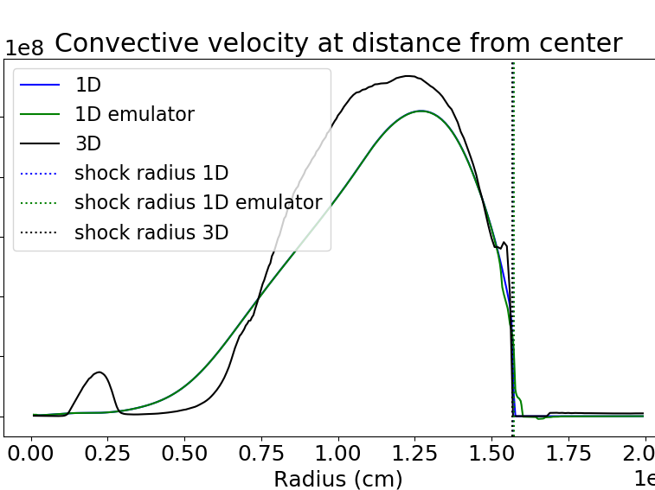
Results of 2-parameter trial (continued)
1 walker, 1 million steps
Apparent best fit:
α_{Λ} = 0.77
α_{D} = 0.50
Notes:
Put percent difference and units

Slide 9
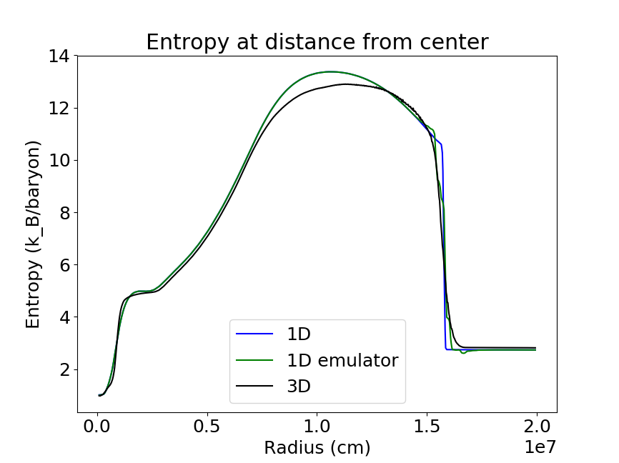
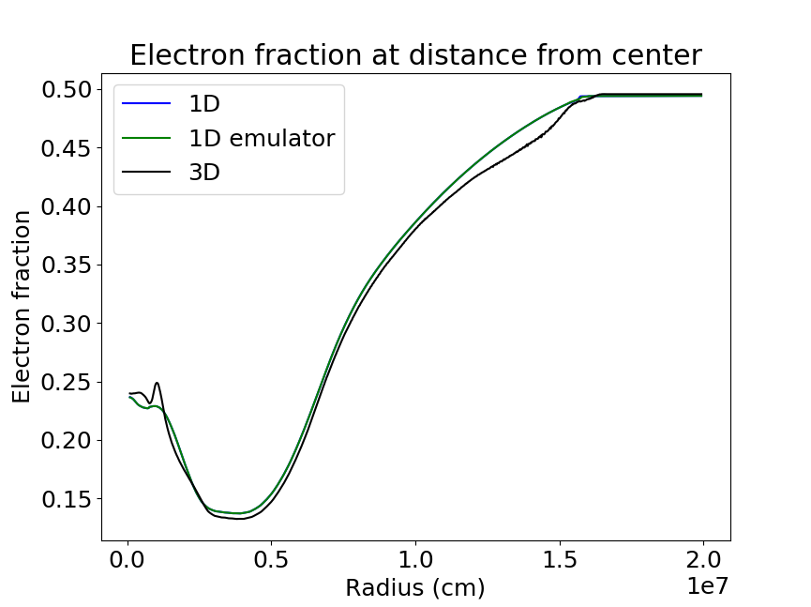
Results of 2-parameter trial (continued)

Slide 10
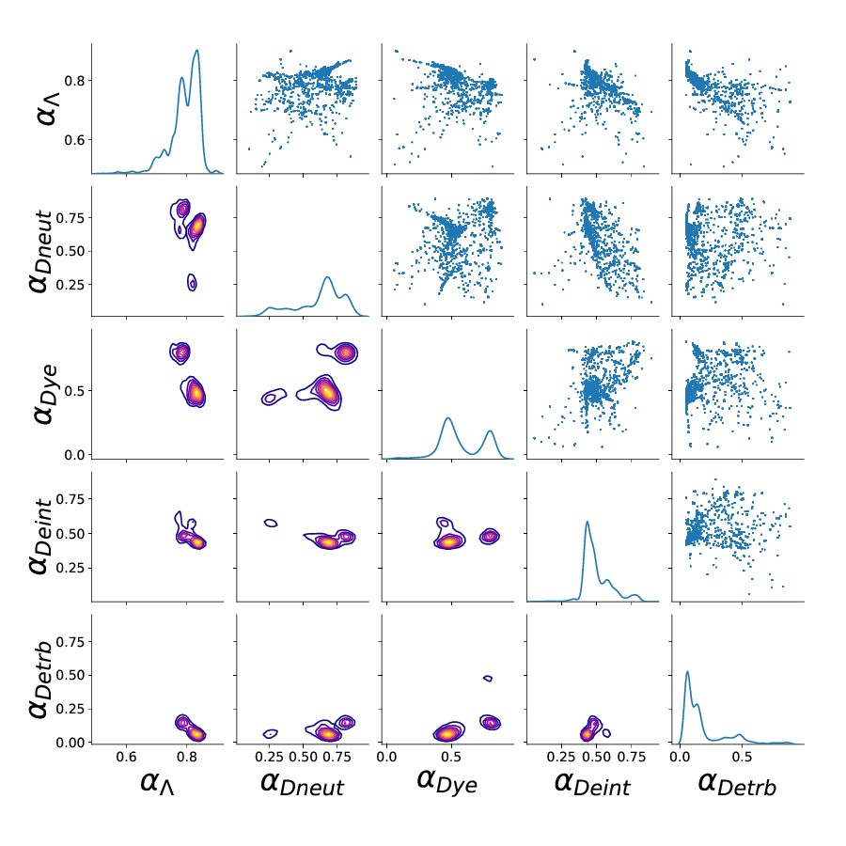
Results of 5-parameter trial
28 walkers, 100,000 steps each
Apparent best fit:
α_{Λ} = 0.87
α_{D, neutrinos} = 0.83
α_{D, electron fraction} = 0.26
α_{D, internal energy} = 0.43
α_{D, turbulent energy} = 0.06

Slide 11
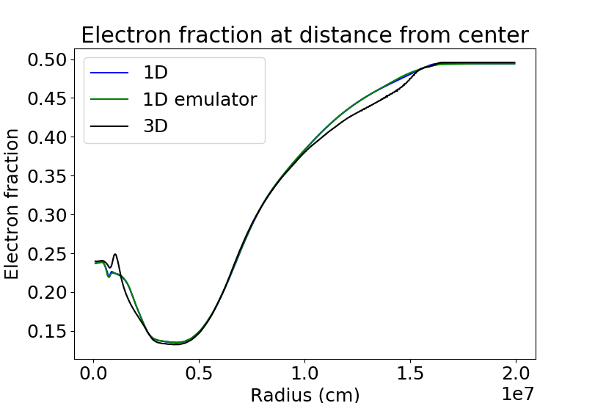
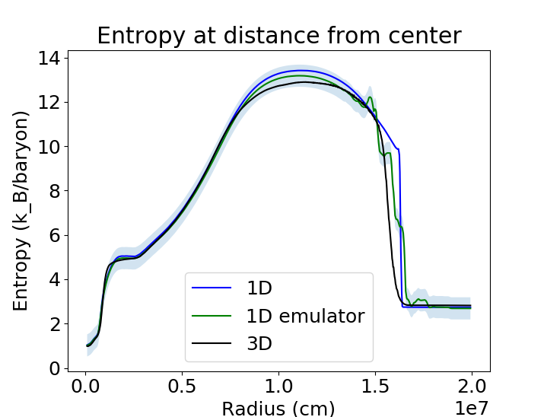
Results of 5-parameter trial (continued)

Slide 12
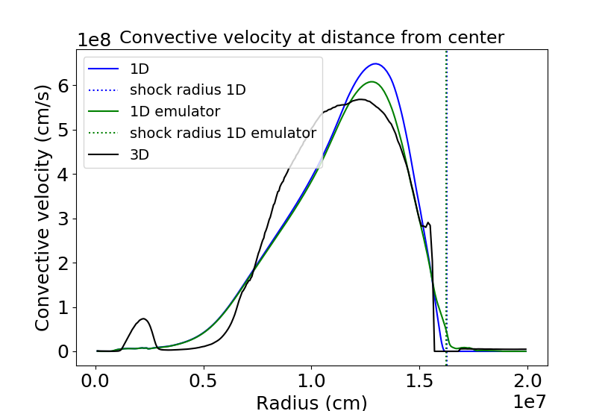
Results of 5-parameter trial (continued)

Slide 13
Next step...more 3D simulations!
Questions?

