Slide 1
Learning Numerical Representations of Biomedical Concepts from 28 Million Abstracts
Jesus E. Vazquez, Anna Yannakopoulos, Kayla Johnson, Christopher Mancuso, Arjun Krishnan
Wednesday, July 25, 2018

Slide 2
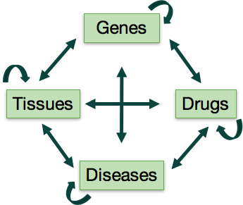
Painting the Big Picture
Making Gene-Gene Claims Steps:
Get a PhD
Read Papers
Spend lots of time identifying specific characteristics to know if 2 genes are related
Can we do this on a computational way? …. Yes

Slide 3
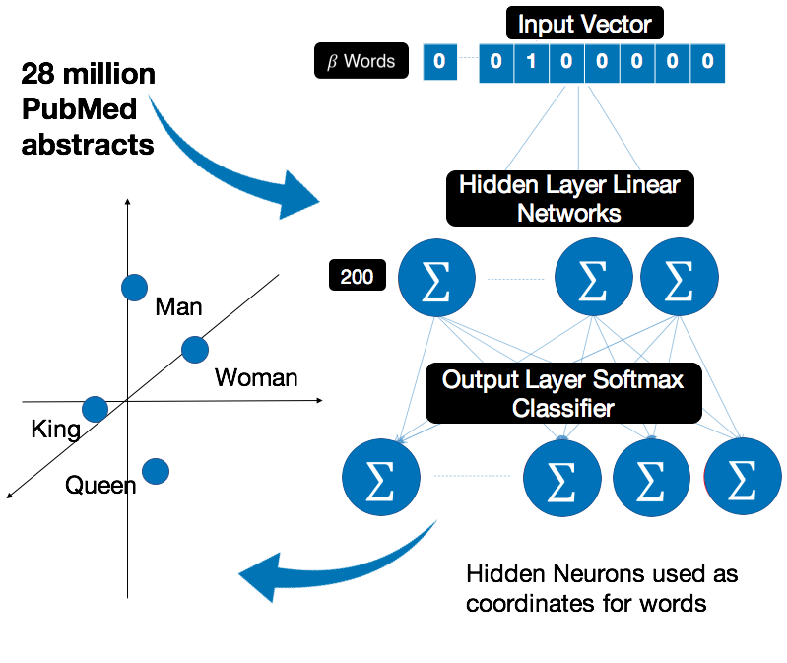
What is Natural Language Processing (NLP)
Analytical techniques for discerning meaning from vast text corpuses. Word2Vec is a neural network model that can learn numerical vector representations of words.

Slide 4
Preparing the Data
200 Features
Primarily prepared the data using Name Entity Recognition
Jesus got a heart attack
Jesus got a myocardial infarction
𝞫 Terms
Word2Vec Model

Slide 5
Evaluation of Word-Embeddings
Gene Ontology (GO) and Disease Ontology (DO) Structures
200 Features
𝞫 Terms

Slide 6
Can our word vectors capture ontology relationships?

Slide 7
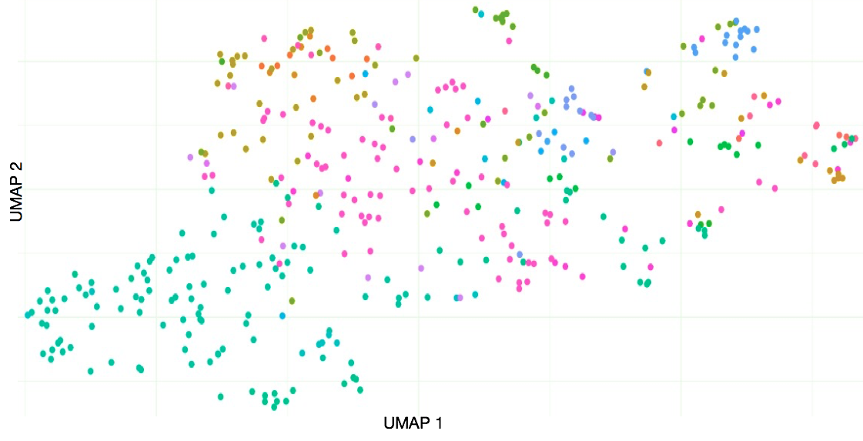
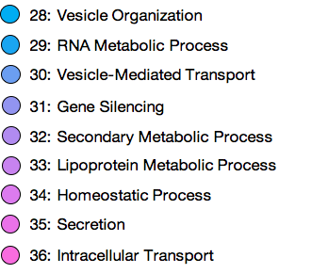
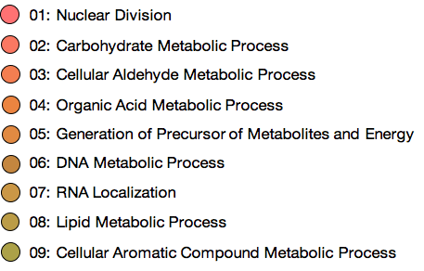
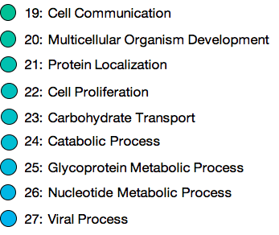
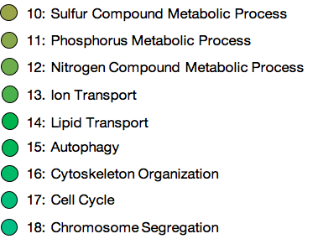
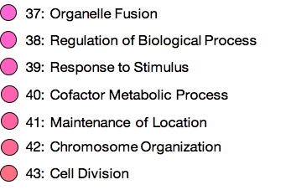
Similar Go Terms are grouped together in vector space

Slide 8
Can word-embedding similarity scores mirror semantic relationships?

Slide 9
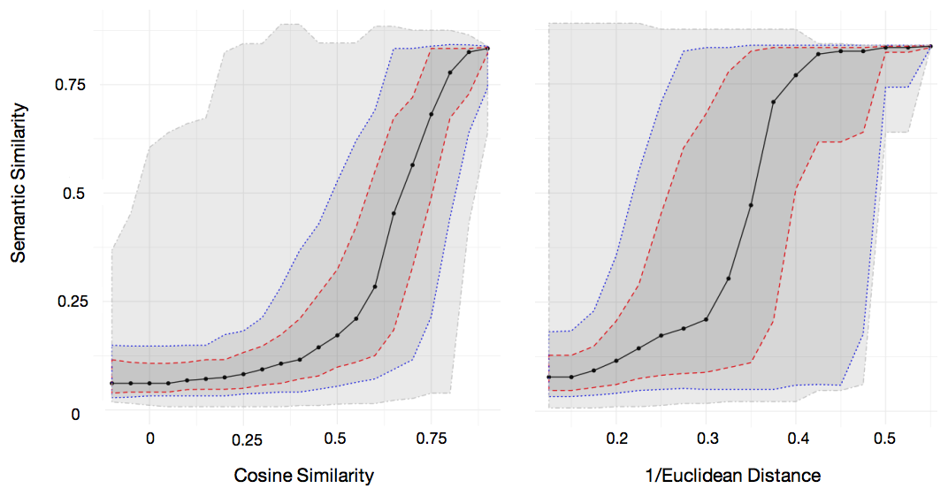
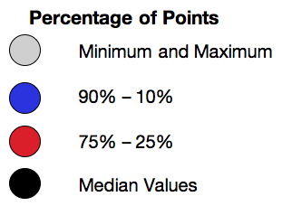
High Similarity Scores Approximate Semantic Relationships
Disease - Disease
Semantic Similarity Between Disease Ontology Terms

Slide 10
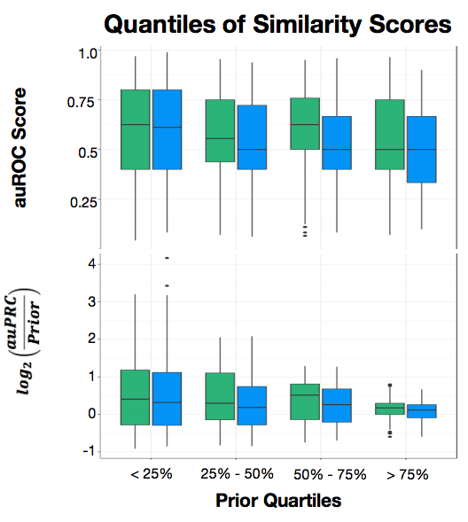
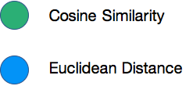
Gene-Function Predictions
Distributions of AUCs per quartile of Prior were better in Cosine Similarity than in Euclidean Distance when predicting gene-function relationships.

Slide 11
From this project we learned:
High values of Cosine Similarity and 1/Euclidean Distance scores approximate the semantic relationship between diseases.
Word embeddings capture the Gene Ontology structure.
Cosine Similarity performs better than Euclidean Distance when predicting gene-function relationships.

Slide 12
Word embeddings can capture ontology relationships
Increasing the precision of word embeddings to associate terms can help us identify not only relationships between functions but relationships between genes, drugs, diseases, and tissues. Further exploration of the subject is needed to validate results.

Slide 13
6. Acknowledgements
This research was supported by the MSU ACRES REU program, which is supported by the National Science Foundation through grant ACI-1560168.
I would like to thank Remy L., Nate D., Mark M., Jake C., Essenam B., Jainil S., Chinaza N., Janani R., and my family for their support this summer.

