Slide 1
Machine Learning to Predict Experimental Protein-Ligand Complexes
Hyunji Kim and Sarah Walworth
Supervising Faculty: Jun Pei and Lin Song
Mentor: Kenny Merz

Slide 2
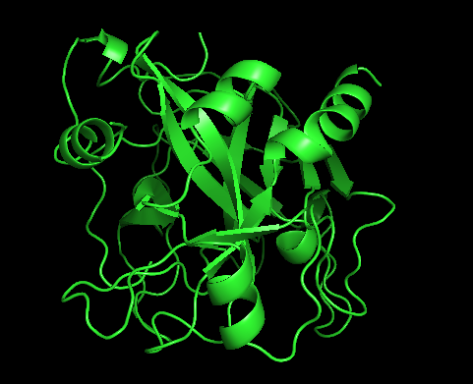
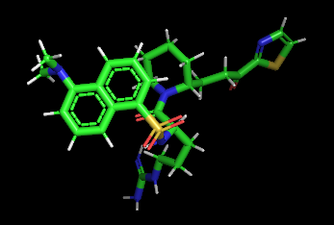
Background
Ligand
Protein
https://www.pinterest.com/pin/814447913832516926/
Notes:
Protein is a large molecules composed of one or more long chains of amino acids
Ligand is any molecule or atom which binds reversibly to a proten
https://www.pinterest.com/pin/814447913832516926/

Slide 3
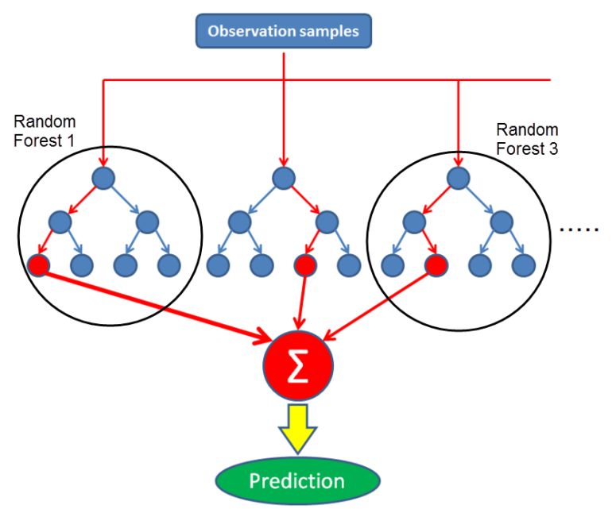
Main Objective
Traditional
Scoring Functions
Random Forest
60%
Notes:
The overall purpose of our data is to improve the ability to predict native crystal structure
General traditional scoring functions have about 60 % accuracy
Therefore for our project, we will be using random forest to improve this accuracy

Slide 4
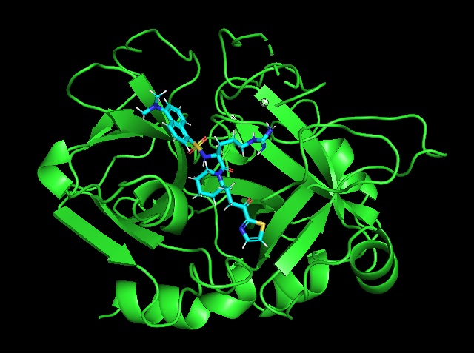
Main Objective
766 Protein-Ligand Crystal Structure
Notes:
The overall purpose of our data is to improve the ability to predict native crystal structure
General traditional scoring functions have about 60 % accuracy
Therefore for our project, we will be using random forest to improve this accuracy

Slide 5
Data Generation
Insert video here!
Schrodinger Glide Software
Notes:
We also applied Garf to approximate potential energy function

Slide 6
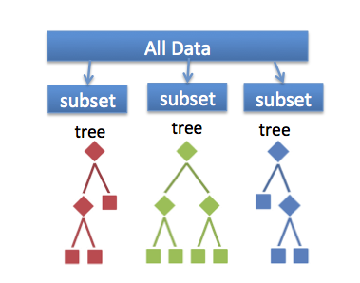
Machine Learning: Random Forest
https://mapr.com/blog/predicting-loan-credit-risk-using-apache-spark-machine-learning-random-forests/
Notes:
RF is created by having a large collection of decision trees
Each tree gives a distinct classification and forest will choose the classification having the most votes over all the other trees
https://mapr.com/blog/predicting-loan-credit-risk-using-apache-spark-machine-learning-random-forests/

Slide 7
Machine Learning: Random Forest
Notes:
•Generated using the Skit-Lean tool
•5-fold cross validation to prevent overfitting
•Randomly select 70% training set and 30% test set.
•Each RF decision tree classify ‘0’ if the rank of native ligand is less than the rank of each ligand decoy and classify a ‘1’ if the rank of native ligand is greater than the rank of each ligand decoy. (or use equation)
•Outcome: training and testing accuracies
https://mapr.com/blog/predicting-loan-credit-risk-using-apache-spark-machine-learning-random-forests/

Slide 8
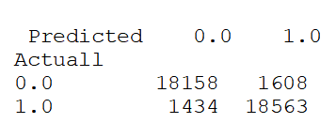
Machine Learning: Random Forest
Confusion Matrix
Notes:
•Generated using the Skit-Lean tool
•5-fold cross validation to prevent overfitting
•Randomly select 70% training set and 30% test set.
•Each RF decision tree classify ‘0’ if the rank of native ligand is less than the rank of each ligand decoy and classify a ‘1’ if the rank of native ligand is greater than the rank of each ligand decoy. (or use equation)
•Outcome: training and testing accuracies
https://mapr.com/blog/predicting-loan-credit-risk-using-apache-spark-machine-learning-random-forests/

Slide 9
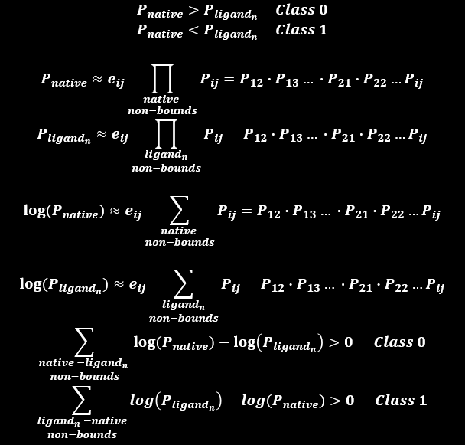

Slide 10
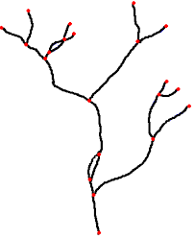
Hyperparameter Tuning: Grid Search
https://giphy.com/gifs/radio-1fDlDkl86AxVK http://www.clipartpanda.com/categories/tree-clip-art-transparent-background http://www.rivex.co.uk/Online-Manual/RivEX-Online-Manual.html?Rivernetworkspecifications.html
Notes:
The main purpose of hyperparameter tuning is to optimize performance
We will “tune” # of decision trees (1000 trees or 2000 trees) and # of features considered for selecting a node (branched in each tree will be adjustified based on the number of trees in the model)
With this best optimal setting is to try tune different combinations and evaluate best performance model
https://giphy.com/gifs/radio-1fDlDkl86AxVK
http://www.clipartpanda.com/categories/tree-clip-art-transparent-background
http://www.rivex.co.uk/Online-Manual/RivEX-Online-Manual.html?Rivernetworkspecifications.html

Slide 11
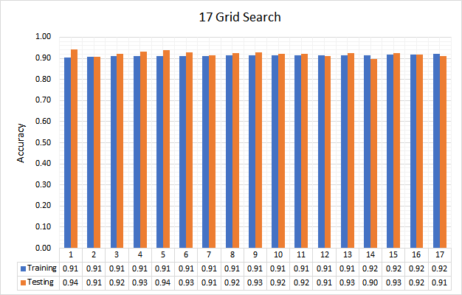
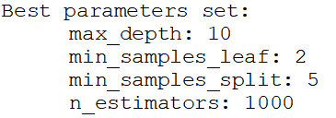
Scikit-Learn: Grid Search Results

Slide 12
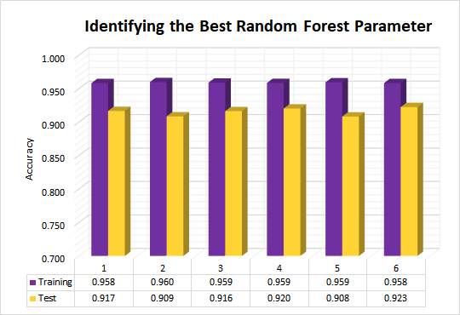
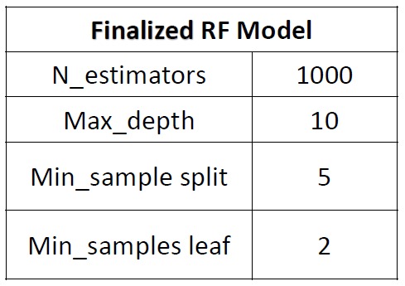
Final Random Forest Parameter

Slide 13
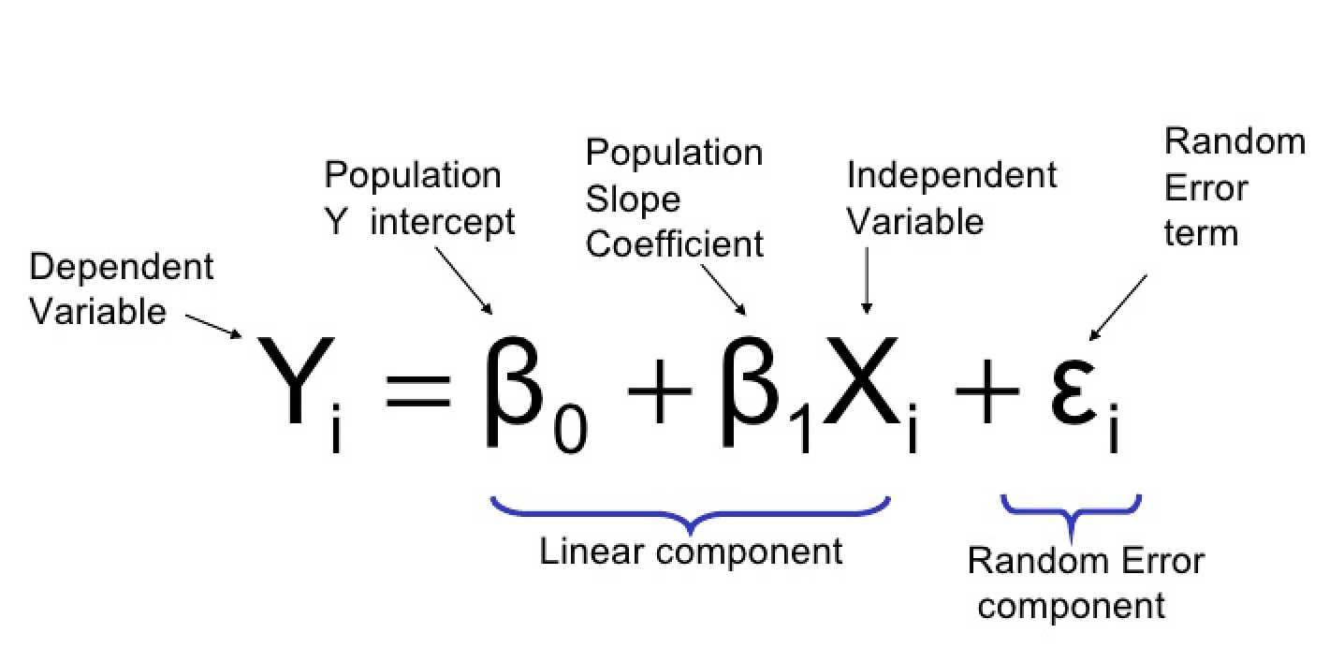
Chemscore
https://towardsdatascience.com/how-are-logistic-regression-ordinary-least-squares-regression-related-1deab32d79f5
Notes:
ASP
Expected number of interactions of atoms in a defined radius
Summation over all protein-ligand atom combinations
Accounts for physical factors and includes a scaling

Slide 14
Astex Statistical Potential (ASP)
https://openclipart.org/detail/282566/grin-smiley
Notes:
ASP
Expected number of interactions of atoms in a defined radius
Summation over all protein-ligand atom combinations
Accounts for physical factors and includes a scaling

Slide 15
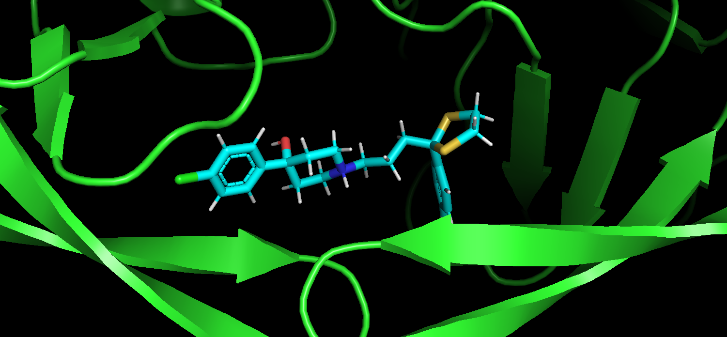
Astex Statistical Potential (ASP)
Notes:
ASP
Expected number of interactions of atoms in a defined radius
Summation over all protein-ligand atom combinations
Accounts for physical factors and includes a scaling

Slide 16
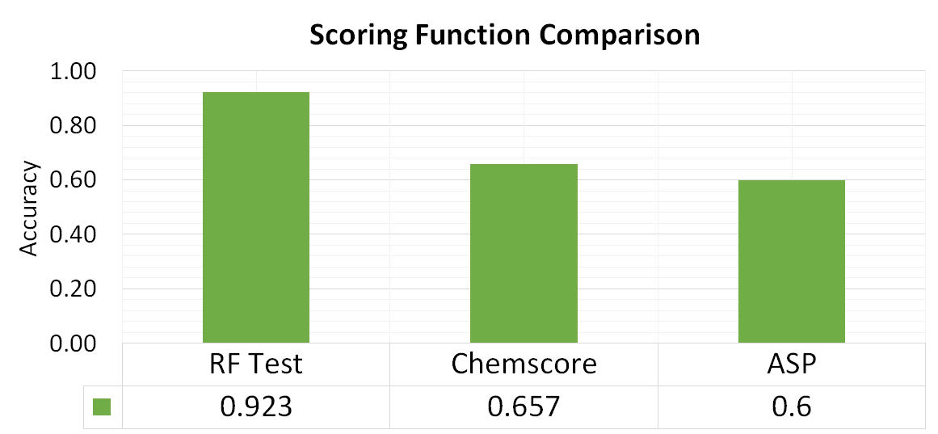
Results

Slide 17
Ongoing Work
https://www.pinterest.com/pin/499829258622082318/

Slide 18
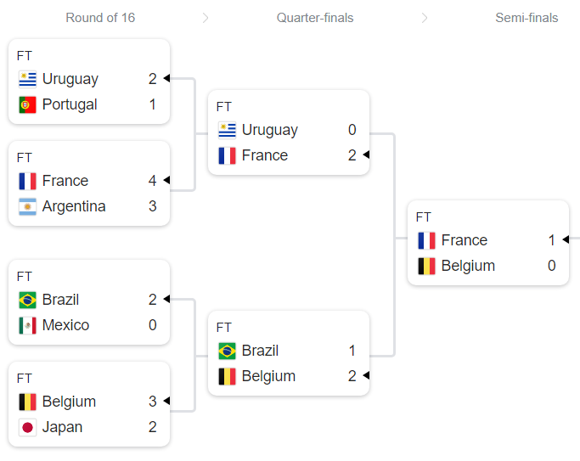
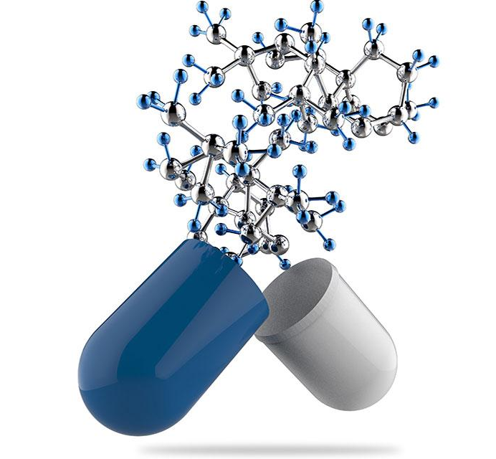
Applications
https://elm.umaryland.edu/tag/new-drug-design/
World Cup 2018: https://www.google.com/

Slide 19
https://tenor.com/search/thank-you-gifs

