Slide 1
Using Deep Learning to Predict Long-Range Regulatory Networks Based On Protein-Protein Interactions
Albert Xue, Binbin Huang, Jianrong Wang

Slide 2
Background: The 1D Genome
Enhancer
Promoter
Gene
97% of the genetic variants associated with disease are caused by noncoding regions in the human genome, which often relate to the regulation of gene expression
Understanding which enhancers affect which promoters can improve our understanding of diseases rooted in the genome

Slide 3
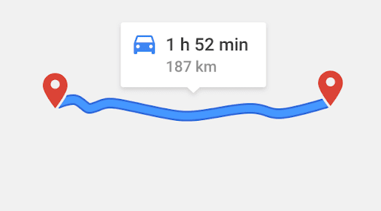
Background: Problems with the 1D Genome
Current methods have difficulty predicting on long-range interactions
Limiting ourselves to short-range interactions inhibits usefulness of model

Slide 4
Background: The 3D Genome
Enhancer
Promoter
Gene
TF
We can rely on enhancer-promoter proximity in 3D space instead of 1D space
To accommodate the transcription factor (TF) complexes binding to both sites, chromatin folds in on itself
By examining enhancer-promoter linkage through these TF complexes, we can understand
chromatin folding
disease-associated genetic variants

Slide 5
Background: TF Interactions
Enhancer
Promoter
Gene
TF
We want to use transcription factor complexes to predict enhancer-promoter linkage
Specifically, we can predict using the interactions between TFs in the complex
By encoding these into an image, we can use a convolutional neural network as our classifier

Slide 6
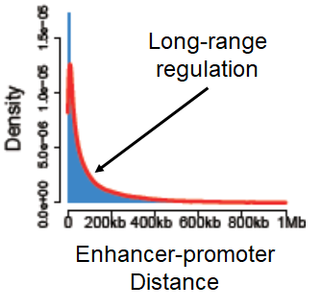
Data: Distance-Controlled Negative Links
We begin with a set of enhancer-promoter links from T-cells
To create a negative set, we generate an equal-sized number of unlinked enhancer-promoter pairs which follow the same distance distribution as the original positive set
A shorter distance between pairs is linked to higher probability of linkage simply because of an increased chance of collision
Want to remove confounding factors
We still need to encode these as images

Slide 7
Data: Template
We create a one-hot encoded protein-protein interaction matrix P as our template (399, 399)
Condition: Both proteins [i, j] must
Have an interaction
Be expressed in our given cell type
We take P + P² to encode indirect interactions

Slide 8
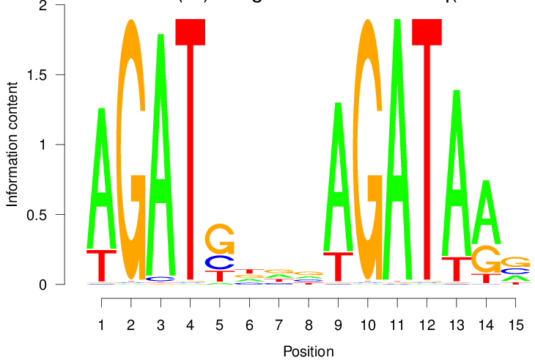
Data: Filtering the Template
For each enhancer-promoter pair in our set (either linked or unlinked) we filter a copy of our template matrix
Condition: For proteins [i,j],
Protein i must have a motif on enhancer
Protein j must have a motif on promoter
Encodes direction of interaction

Slide 9
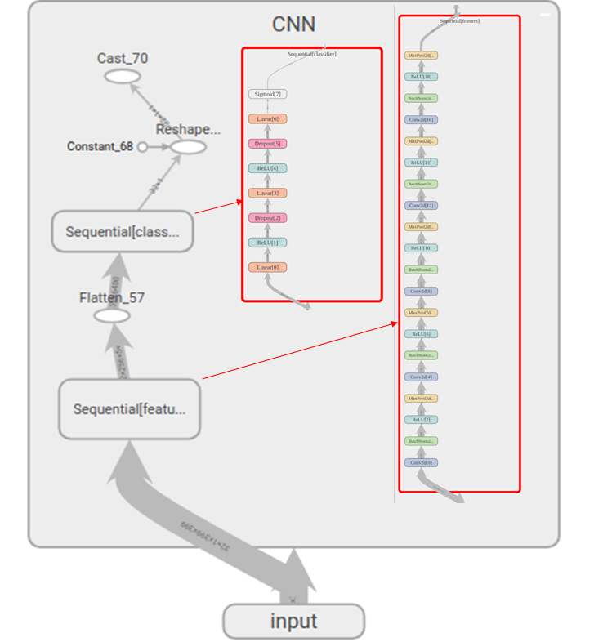
Model: What We Tried
Transfer Learning from VGG-16
Shallow Network
Various hyperparameters

Slide 10
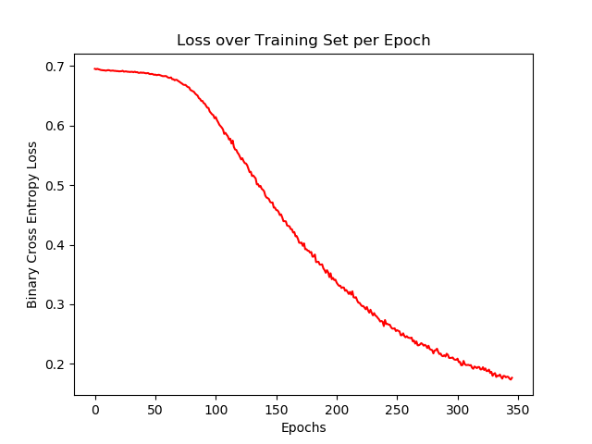
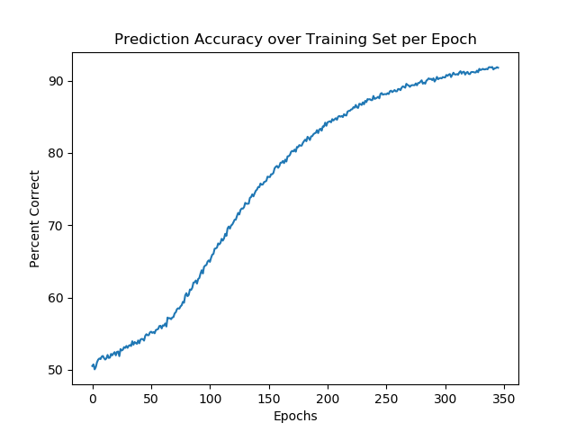
Results: Overfitting
Training reduced loss to 0.1767 and raised prediction accuracy to 91.80%, but validation prediction accuracy remained constant at 54%

Slide 11
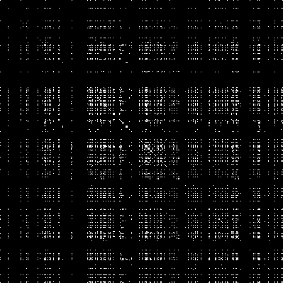
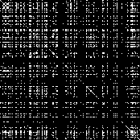
Future Work: Immediate Model Improvements
Utilizing motif ambiguity in clustering could reduce sparsity and improve generalizability of sampled features

Slide 12
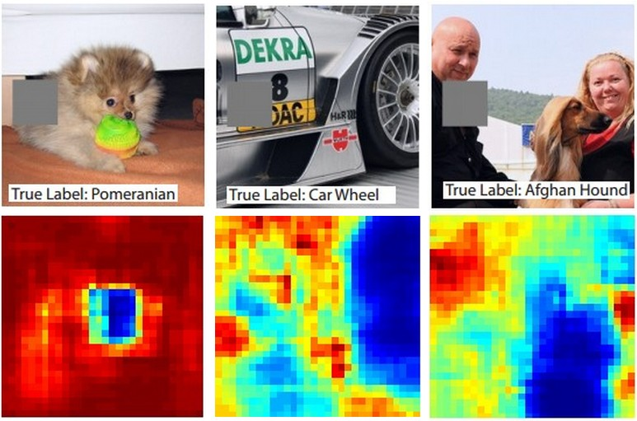
Future Work: Feature Extraction
Image occlusion can help us determine the most important parts of our image for classification

