Slide 1
Finding New Compounds for Soluble Epoxide Hydrolase (sEH) Inhibition Through Virtual Screening
Elizabeth Tuason
Arzu Uyar & Samuel D Lotz
Alex Dickson

Slide 2
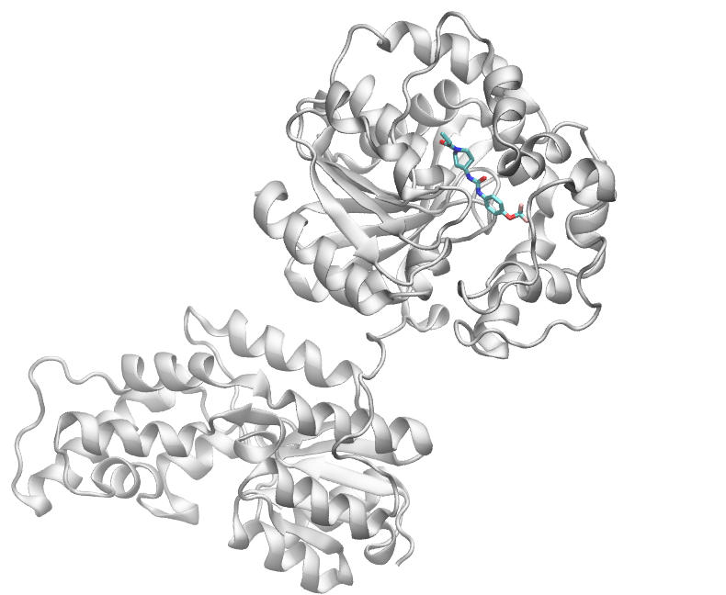
Soluble Epoxide Hydrolase (sEH)
Soluble epoxide hydrolase is a protein.
When inhibited has been shown to be an effective pain treatment for neuropathic pain caused by diabetes in rodents.
Goal: Find new structures that could serve as sEH inhibitors using TPPU as a template
sEH protein and TPPU ligand
(Pictures taken in VMD)

Slide 3
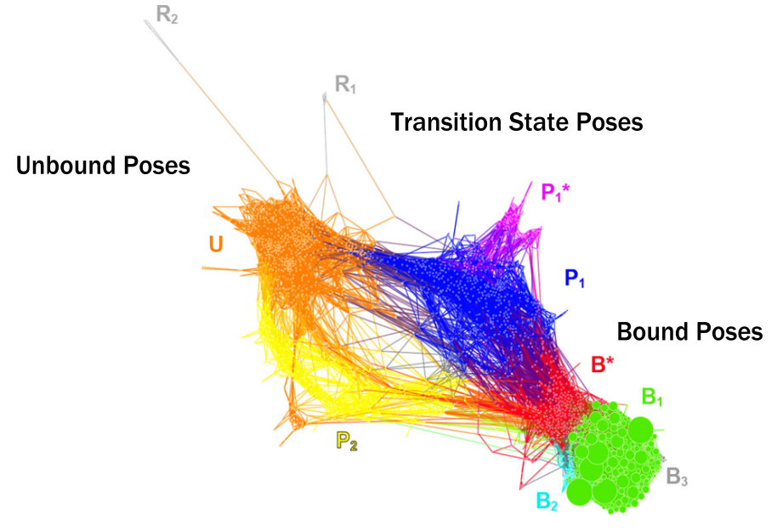
Using Previous Data
Data from previous study with unbinding simulations of the sEH and TPPU (Lotz and Dickson, JACS, 2018)
Examined 2000 cluster representatives from the Conformation Space Network(CSN)

Slide 4
Finding Alternative Bound State Poses
Look at the neighborhood (bound, unbound, or transition state)
Graphed RMSD (root-mean-square deviation) vs. SASA (solvent accessible surface area) and probability
Examine interactions
Hydrogen bond donors/acceptors, aromatic rings, hydrophobic groups

Slide 5
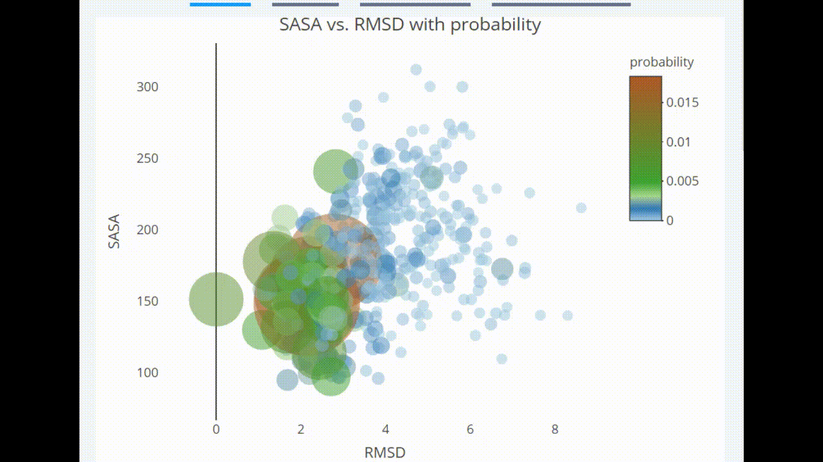
Interactive Bubble Graph
Data from previous study with unbinding simulations of sEH and TPPU
SASA along the y-axis
RMSD along the x-axis
Probability - size and color of the bubbles
(Plot made using the Plotly package)

Slide 6
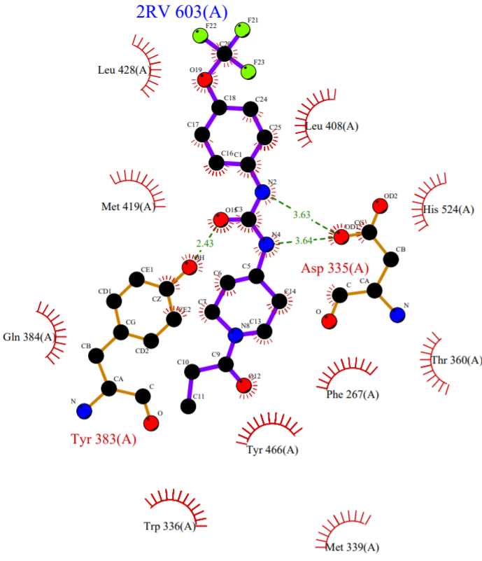
Examining Interactions
Map of the interactions (from PDBsum)
Given a list of all the possible hydrogen bonds calculate from the cluster representatives
LIGPLOT of interactions involving ligand TPPU (resname 2RV)

Slide 7
Pharmacophore Based Virtual Screening
Pharmacophore - abstract description of essential features for a ligand to interact with a biomolecule
(e.g. Hydrogen bond donors/acceptors, aromatic rings, hydrophobic groups)

Slide 8
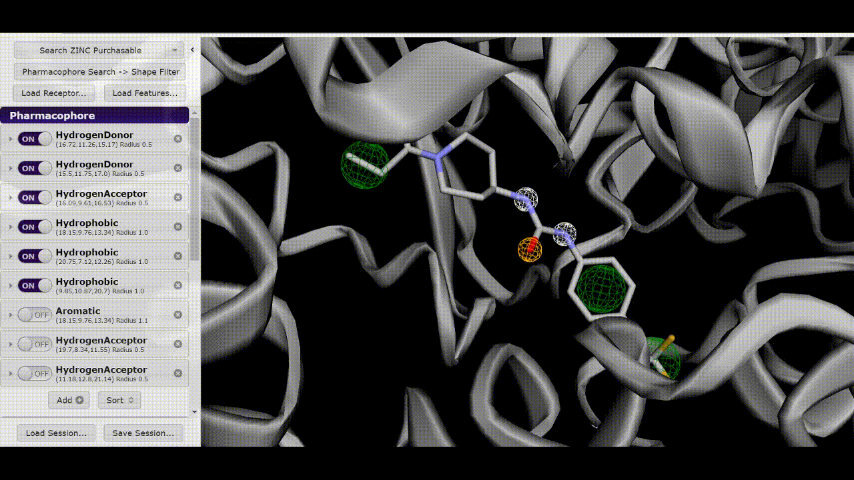
Finding New Compounds
Pharmit - online tool to search a database of structures based on the given structure and pharmacophores
Returns a ligand dataset
(http://pharmit.csb.pitt.edu)

Slide 9
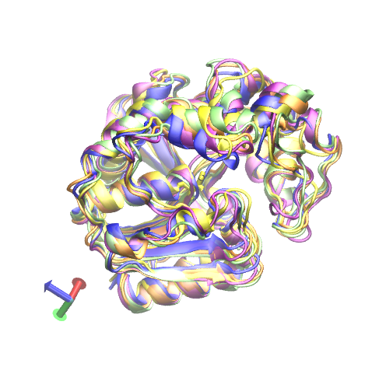
Docking Selected Poses
Ligand Sets (from Pharmit)
Protein Conformations
Crystal Structure Set
Crystal Structure
Blue
Alternative Bound State (1)
Purple
Alternative Bound State (2)
Lime
Transition State (1)
Orange
Transition State (2)
Yellow
Alternative Bound Pose Set (1)
Alternative Bound Pose Set (2)

Slide 10
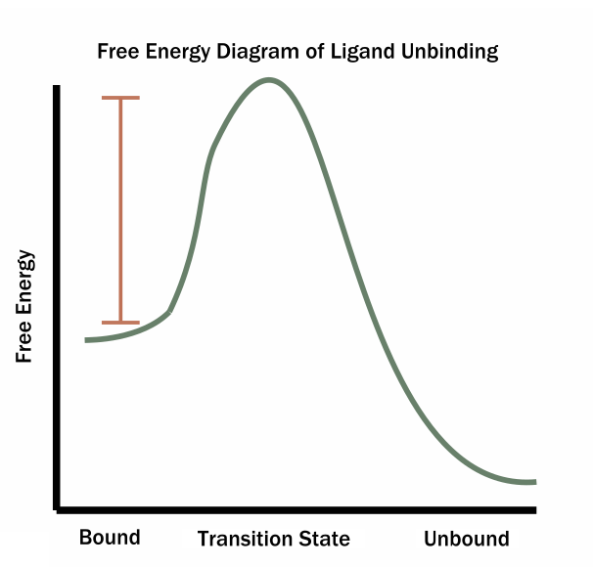
Free Energy Diagram
Maximize Free Energy difference between the bound and unbound states

Slide 11
Finding Transition State Poses
Look at the neighborhood (bound, unbound, or transition state)
Probability

Slide 12
Schrödinger Glide Docking Software
Docking
Dock all ligands to the chosen sEH poses
Returns a docking score based on how well ligand is bound to the protein
High Score = Poor Score (e.g. -2.00)
Low Score = Good Score (e.g. -7.00)

Slide 13
Analyzing Results
Looked for ligands with good docking scores for bound poses
Ligands with poor docking scores for transition state poses

Slide 14
Ligand Datasets
12, 131 structures with docking scores below -6.5
2,422 unique structures
287 structures overlapped

Slide 15
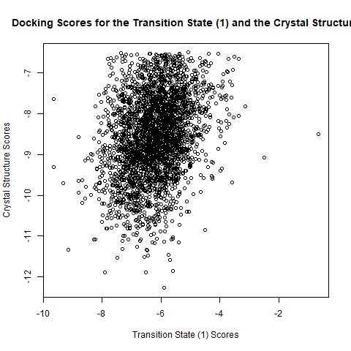
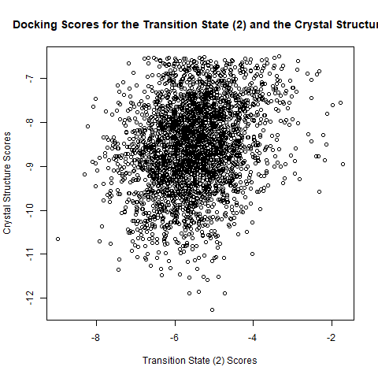
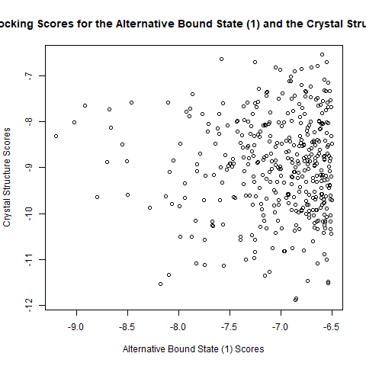
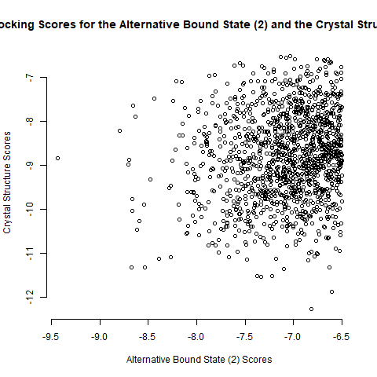
Scores Graphed

Slide 16
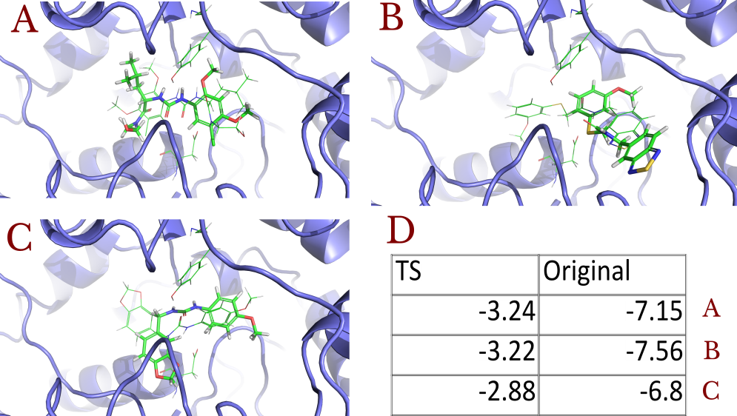
Sample Ligands

Slide 17
Further Research
Structures can be used new unbinding simulations and classical molecular dynamics simulations
Predict the residence time (i.e. time ligand is bound to the protein)
Interesting structures could be tested as possible drugs to treat pain

Slide 18
References
Lee, Kin Sing Stephen; et. al. 2014. Optimized Inhibitors of Soluble Epoxide Hydrolase Improve in Vitro Target Residence Time and in Vivo Efficacy. Journal of Medicinal Chemistry 2014 57 (16), 7016-7030.
Humphrey, W., Dalke, A. and Schulten, K., "VMD - Visual Molecular Dynamics", J. Molec. Graphics, 1996, vol. 14, pp. 33-38.
Laskowski, R. A.; Hutchinson, E. G.; Michie, A. D.; Wallace, A. C.; Jones, M. L.; Thornton, J. M. PDBsum: A Web-Based Database of Summaries and Analyses of All PDB Structures. Trends Biochem. Sci. 1997, 22 (12), 488−490.
Lotz, Samuel D and Dickson, Alex. 2018. Unbiased Molecular Dynamics of 11 min Timescale Drug Unbinding Reveals Transition State Stabilizing Interactions. Journal of the American Chemical Society 2018 140 (2), 618-628.
Jocelyn Sunseri David Ryan Koes Nucleic Acids Research, Volume 44, Issue W1, 8 July 2016, Pages W442–W448
Schrödinger Release 2018-2: Glide, Schrödinger, LLC, New York, NY, 2018.
The PyMOL Molecular Graphics System, Version 2.0 Schrödinger, LLC.

