Slide 1
LINKING DISEASE- ASSOCIATED GENETIC VARIANTS TO GENES USING SEQUENCE AND 3D CONTACTS
Chinaza Nnawulezi
Research Mentors: Arjun Krishnan and Jianrong Wang
CMSE Research Overview
7/25/2018

Slide 2
What makes us all different?

Slide 3
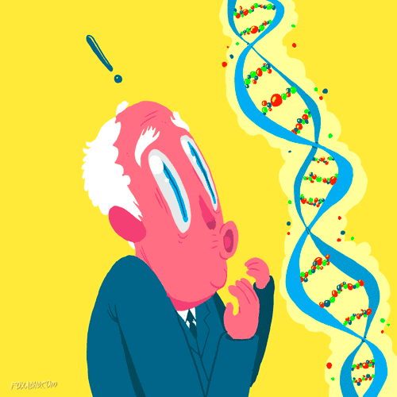
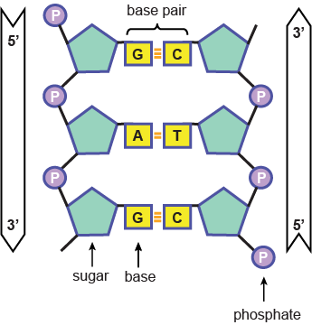
What makes us all different?
GENES!
Less than 2% actually
SNPs

Slide 4
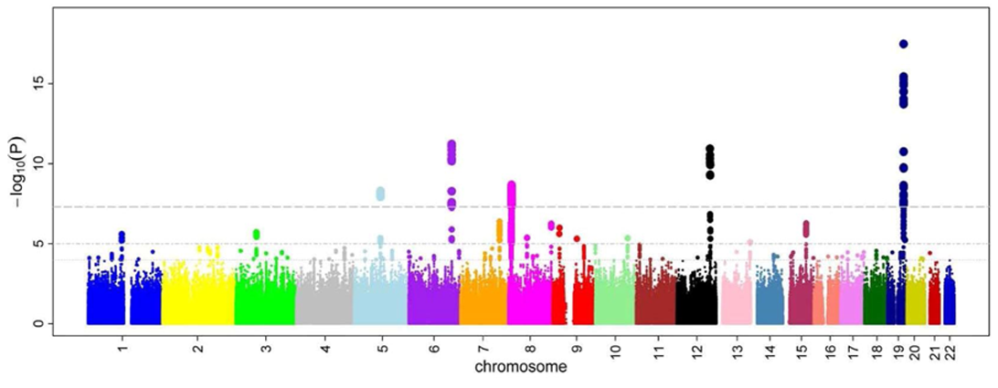
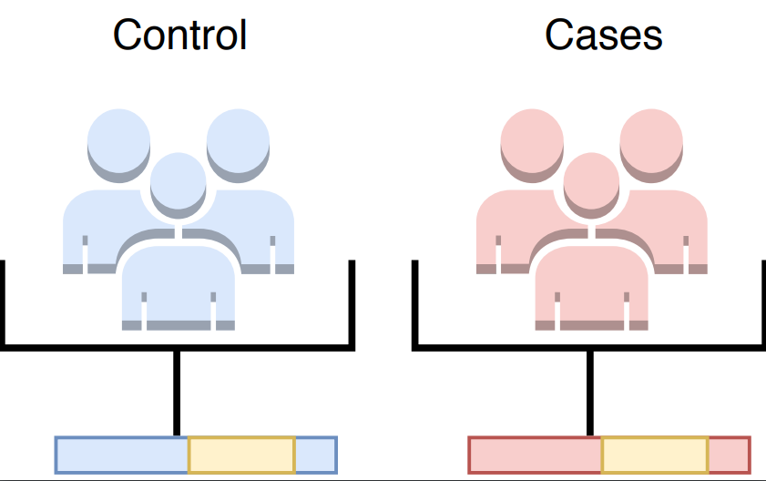
Genome Wide Association Studies (GWAS)

Slide 5
How can we use this knowledge to our advantage?
Many SNPs are associated with phenotypes
By understanding which SNPs are related to a disease, genes and pathways follow
With more knowledge of gene networks, we excel!
Notes:
Use a visual for this

Slide 6
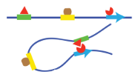
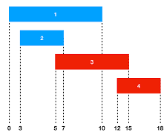
How can we do this ? (Method Comparison)
Long Range linkage
Chromatin interactions showing further away interactions (Chia-PET data)
Grouping similar genes/ enhancers/promoters together (island formation)
2
Short Range Linkage
GWAS studies
Gene correlation
Pathway analysis
Distance: 100,000 bp
6
Distance: 10,000 bp
Notes:
Edit length, enlarge pic, remove bullets, desciption of chiapet, diagram of island formati

Slide 7
What is MY project?
Be able to utilize two different methods (long and short range) to be able to link different genetic variants(SNPs) to genes and ultimately relate them to biological pathways.

Slide 8
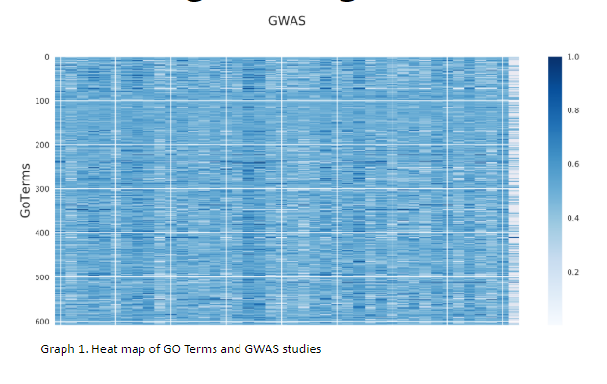
Pathway Enrichment
Phenotype
1\\
GO term
2
3
genes
genes

Slide 9
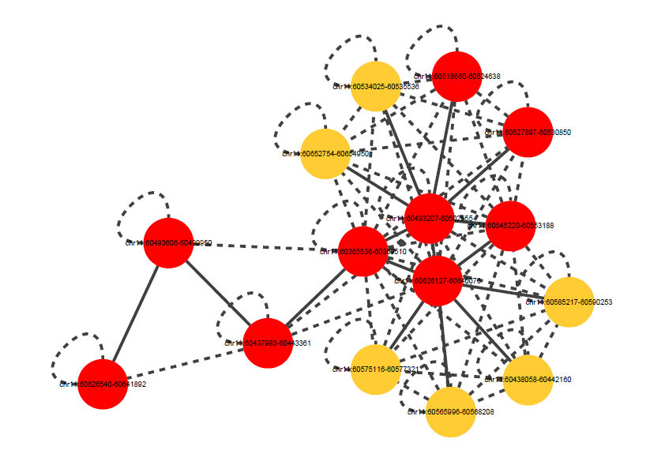
3D Long Range Interaction Network
From Chia-PET analysis
Solid line = direct interaction
Dashed line = indirect interaction
Node = enhancer/ promoter
RED: promoter
YELLOW: enhancer
2
Linking genes that are further away
3

Slide 10
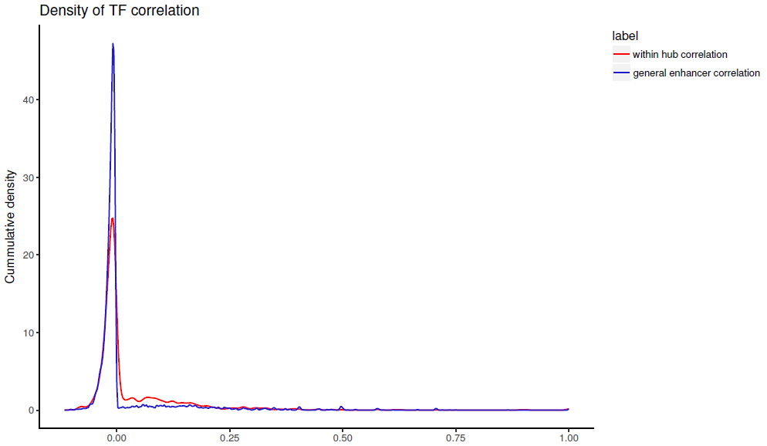
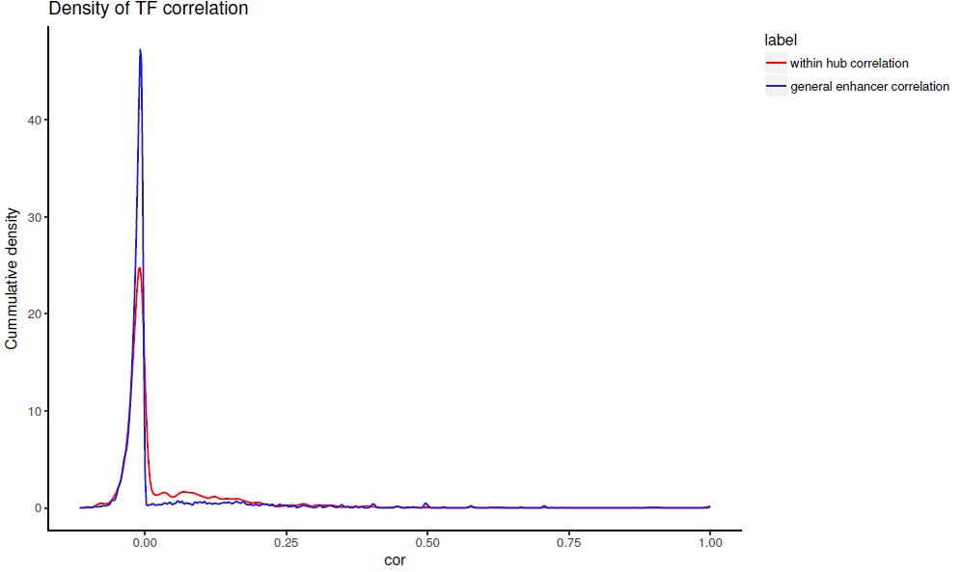
Motif Co-occurrence Enrichment Distribution
Suggests that enhancer nodes within the same network work together
Due to them sharing similar transcription factor binding signatures
2
Linking genes that are further away
3
Larger motif-profile correlations
More similar motif-profile than background
Motif co-occurrence profile Correlations among Enhancers
Notes:
compares

Slide 11
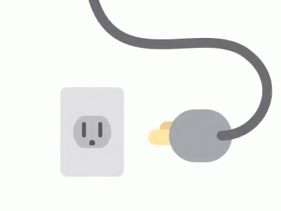
How do we get the best of both worlds?
Look for interactions between the SNPs/Genes and long range network
2
3

Slide 12
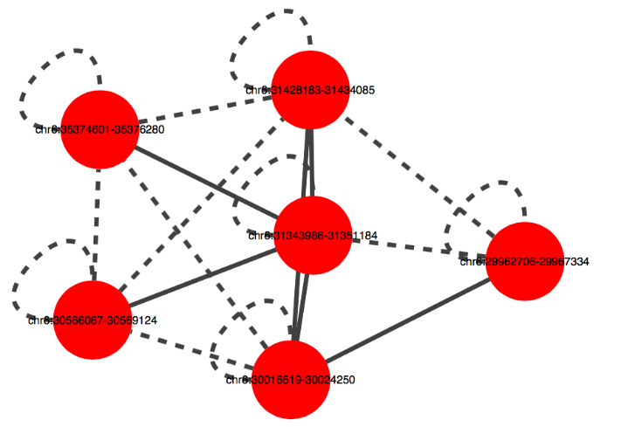
Interacts with SNPs that have been associated with Lupus
(4 nodes overlap with significant SNPs from GWAS)
2
3

Slide 13
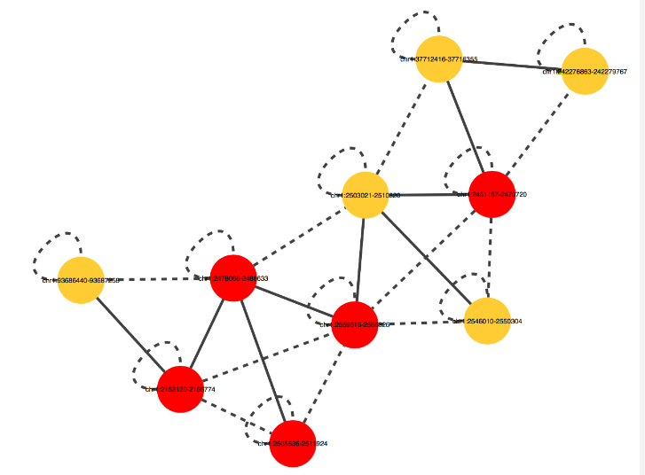
Interacts with SNPs that have been associated with Colitis
(6 nodes overlap with significant SNPs from GWAS)
2
3

Slide 14
Difficulties and Future Directions
New to coding
So NOTHING ever runs
Very large datasets
Takes a while to have complete output
Heat map clustering
Noise reduction
1
2
3

Slide 15
THANK YOU! :)

Slide 16
QUESTIONS?

