Slide 1
Anakin-ME through the study of Protein-ligand dynamics
Jasmin Whitaker
Mentor: Nazanin Donyapour
PI: Alex Dickson

Slide 2
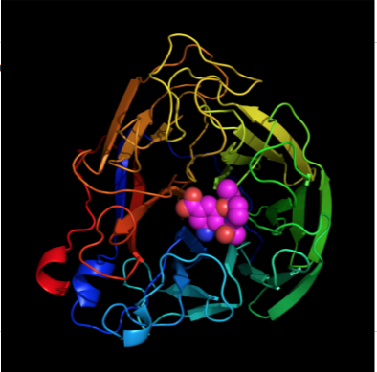
Introduction
What is a protein
Highly complex substances present in all living organisms.
Notes:
Examples of protein within the human body are things like keratin, collagen, insulin, antibodies...etc.

Slide 3
What is a ligand
A ligand is a molecule that has the ability to bind to and form complexes with other biomolecules (i.e proteins) to perform biological processes.
Examples of ligands:
Drugs
Inhibitors
Hormones
Notes:
In regards to protein-ligand binding, a ligand is usually a molecule which produces a signal by binding to a site on a target protein through intermolecular forces.

Slide 4
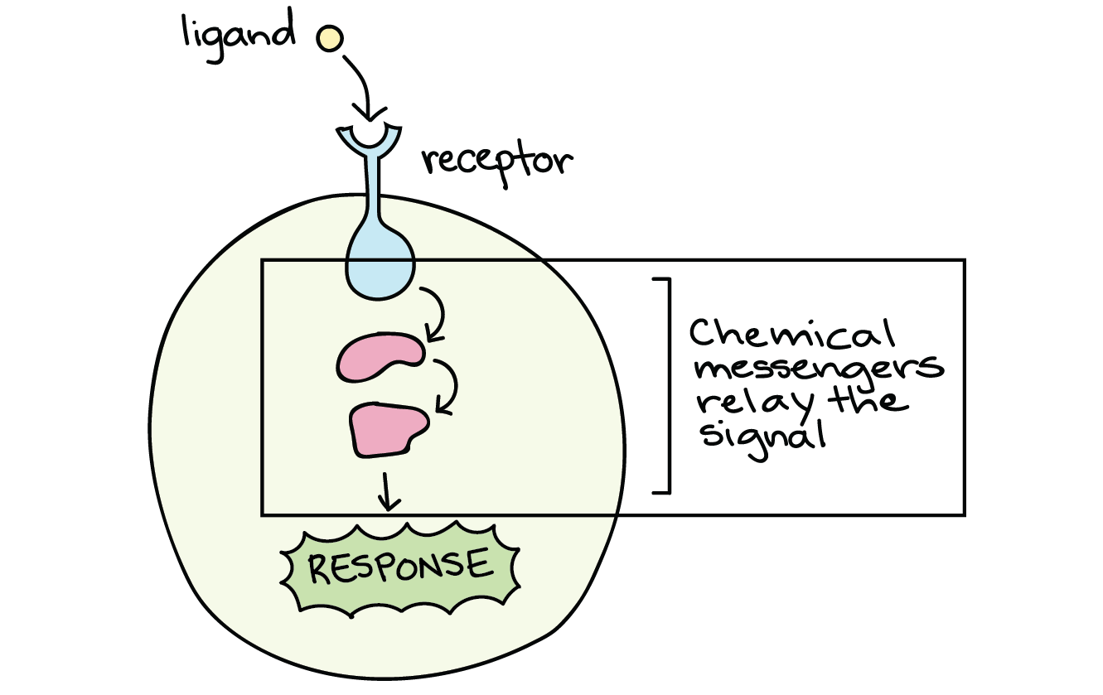
What happens when a ligand binds or unbinds from a protein and what possible outcomes can come from such?
Notes:
Like in the picture displayed, When a ligand binds to its receptor, it sends off signals which are relayed by messengers. Ultimately when these signals are received, the cell will respond in some way depending on what the biological purpose of ligand was to produce.

Slide 5
Quantum Mechanical MD vs. Classical MD
Quantum Mechanical MD allows simulations to be ran where topologies aren’t fixed.
We can simulate deprotonation, tautomerization, formation and breakage of bonds.
These energies and changes can be done using the Schrodinger equation.
slow
Classical MD
Utilizes fixed topologies
Fast

Slide 6
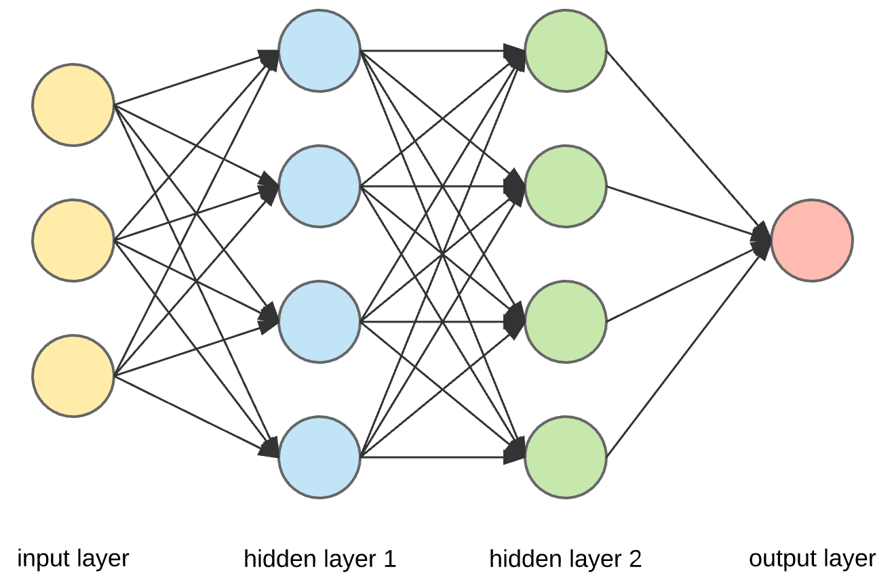
Focus: Anakin-ME
What is Anakin-ME?
What do we expect ANI to do and how can this help enhance protein-ligand dynamics?
Notes:
Anakin is a fast, reactive forcefield which has the same capabilities as QMMD with near-classical efficiency. Anakin was trained on neural network processors, which allows the forcefield to predict a systems energy and forces given only a set of atoms and their positions. When the simulation is occurring we expect ANI not only to predict these energies and forces, but also show/ allow any changes within the topology if possible. (if reactions occur ANI will allow this to be shown) Due to these reactions being allowed to occur makes the simulation much longer; however, the overall goal is for this method to pave the way for more accurate simulations to be used in drug discovery We particularly expect this method to help improve the selectivity of covalent inhibitors, by modeling covalent attachment to target and off-target proteins

Slide 7
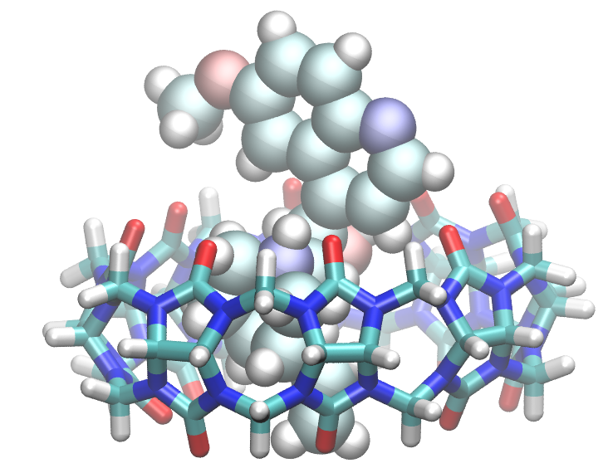
Objectives
Determine benchmarks for Anakin while running simulations.
Implement Atomic Simulation Environment (ASE) as a runner within WEPY
Demonstrate through simulations the deprotonation of molecules within the system.
Further deepen the accuracy within simulations for drug development.

Slide 8
Methods
ASE- Atomic Simulation Environment is used to set up, run, visualize, etc. atomistic simulations
NPTBerendsen: a thermostat to keep temperature constant
Velocity Verlet: an integrator to keep energy constant
LBFGS OPTIMIZER- controls the motions of atoms
Wepy- Weighted Ensemble Python (S. D. Lotz)
REVO Algorithm
Notes:
Wepy is a computer program that launches trajectories. It then looks at there outputs to decide which ones are substantial enough to use for the next cycle. Overall, we want to find outliers so it takes these outliers and utilizes them to perform the next cycles. How that is done depends on algorithm and ways you identify outliers is based on the event you want to see.

Slide 9
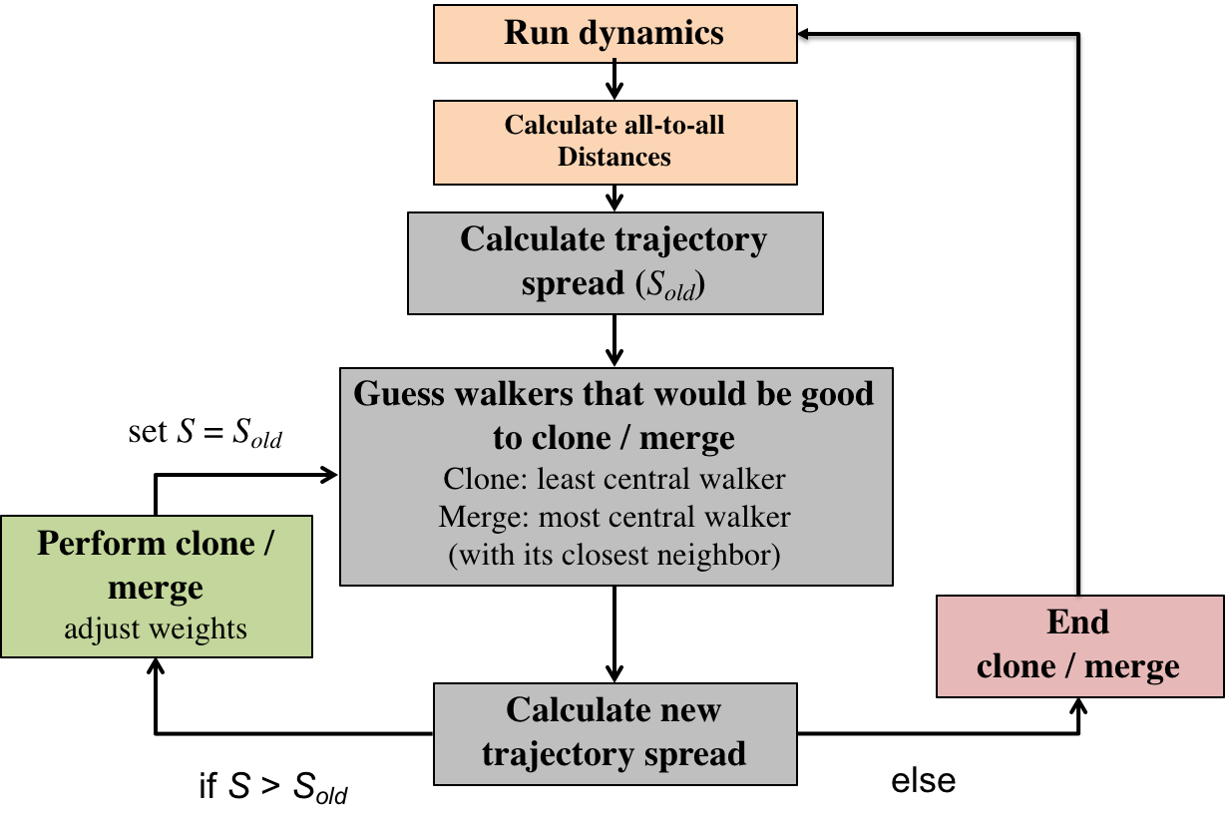
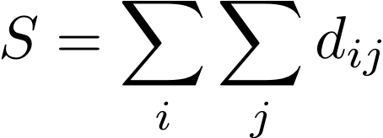
Revo Algorithm
Optimize S:
Notes:
Revo is easy to conceptualize. Revo finds outliers by optimizing the spread function. Revo doesnt define any regions. Running the dynamics is just reading and loading trajectories.

Slide 10
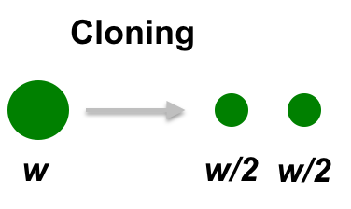
Merging

Slide 11
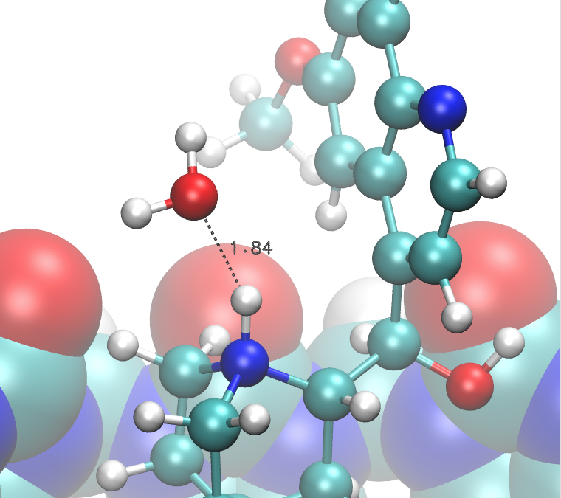
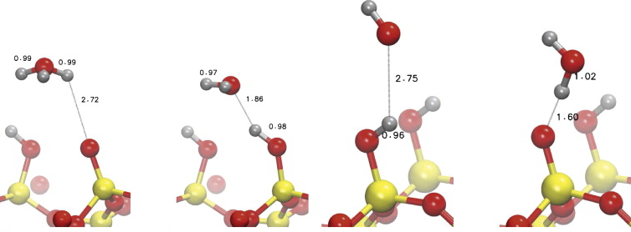
Distance Metric Used to determine Deprotonation distance
Where alpha is scaling factor of the distance.

Slide 12
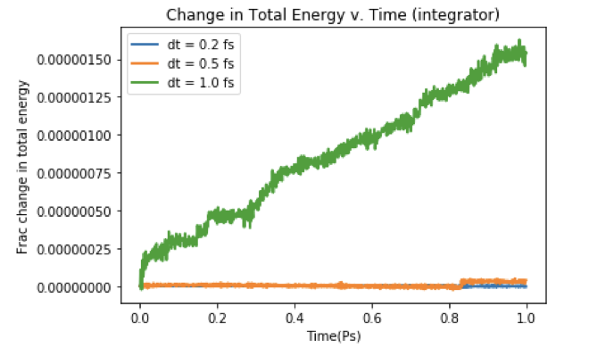
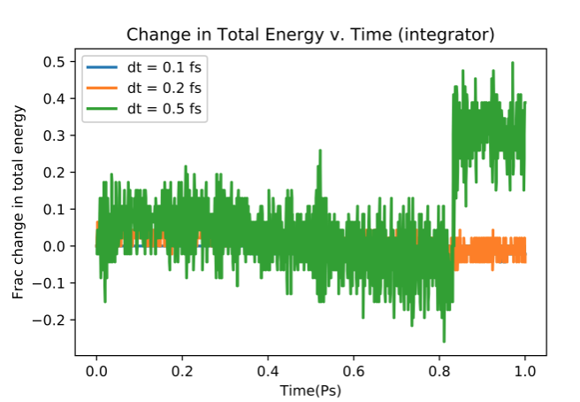
Results
Figure 1. The change in total energy over the course of one picosecond viewed between three different time steps to determine if total energy remains constant.
Figure 2. The change in total energy over the course of one picosecond viewed between three different time steps to determine if total energy remains constant.
Notes:
Mention the scaling. It’s 4.6295e6 million plus the y-axis. Also mention why/ how we chose the timestep.

Slide 13
Results
Benchmark updates
Over the course of both 1 femtosecond and 0.5 femtoseconds the total amount of walltime these two took for 10,000 steps was about 14 minutes
NOTE: Determining benchmarks for the Anakin forcefield is important because we want to make sure that what we are doing is efficient and more useful than QMMD and worth the effort compared to classical MD.

Slide 14
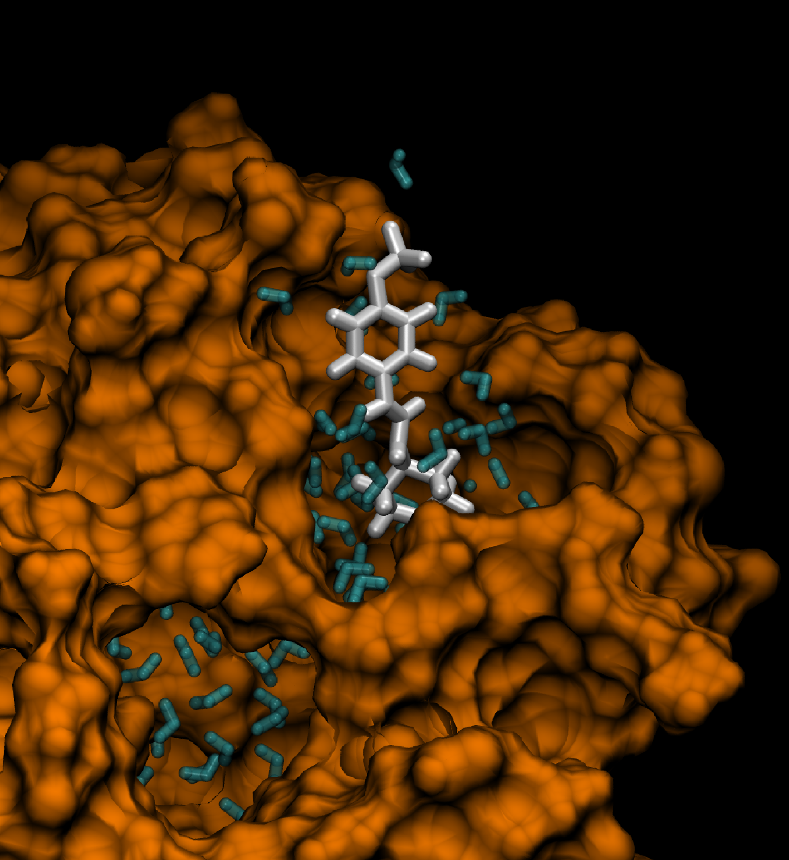
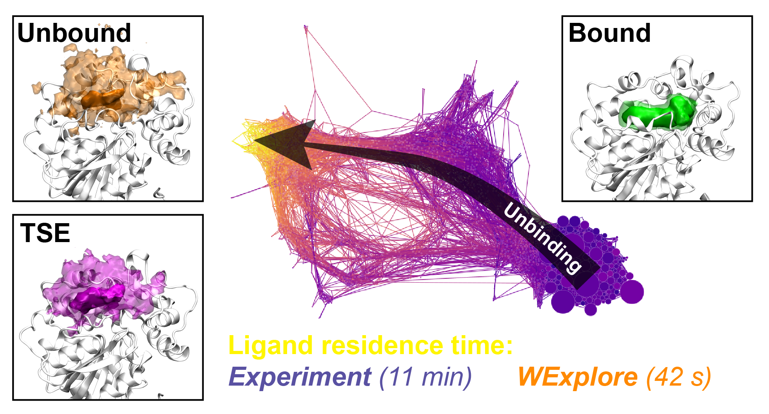
Future Work
After debugging ASE runner within WEPY, there are many opportunities for future work:
Run deprotonation, formation/breakage of bonds, and tautomerization simulations.
Run binding/unbinding simulations
(Lotz SD and Dickson A)

Slide 15
References
arXiv:1610.08935v4 [physics.chem-ph]
Ask Hjorth Larsen, Jens Jørgen Mortensen, Jakob Blomqvist, Ivano E. Castelli, Rune Christensen, Marcin Dułak, Jesper Friis, Michael N. Groves, Bjørk Hammer, Cory Hargus, Eric D. Hermes, Paul C. Jennings, Peter Bjerre Jensen, James Kermode, John R. Kitchin, Esben Leonhard Kolsbjerg, Joseph Kubal, Kristen Kaasbjerg, Steen Lysgaard, Jón Bergmann Maronsson, Tristan Maxson, Thomas Olsen, Lars Pastewka, Andrew Peterson, Carsten Rostgaard, Jakob Schiøtz, Ole Schütt, Mikkel Strange, Kristian S. Thygesen, Tejs Vegge, Lasse Vilhelmsen, Michael Walter, Zhenhua Zeng, Karsten Wedel Jacobsen The Atomic Simulation Environment—A Python library for working with atoms J. Phys.: Condens. Matter Vol. 29 273002, 2017
Lotz and Dickson. 2018. JACS 140 (2) pp. 618-628 (DOI: 10.1021/jacs.7b08572)
Lotz SD and Dickson A*.Journal of the American Chemical Society. (2018) *image

Slide 16
Acknowledgements
Special Thanks:
Nazanin Donyapour
Dr. Alex Dickson
My Research lab members
ACRES
iCER
National Science Foundation through grant ACI-1560168.

Slide 17
QUESTIONS?

