Slide 1
Adaptive Mesh Refinement
for the
Smoothed-Boundary Method
Kieran Fitzmaurice
Mentor: Dr. Hui-Chia Yu
ACRES REU 2018

Slide 2
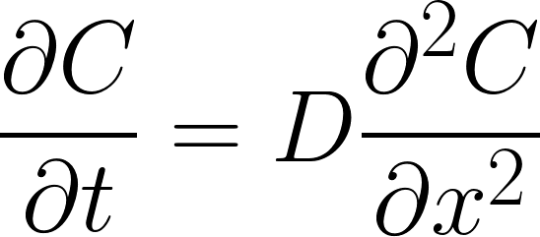
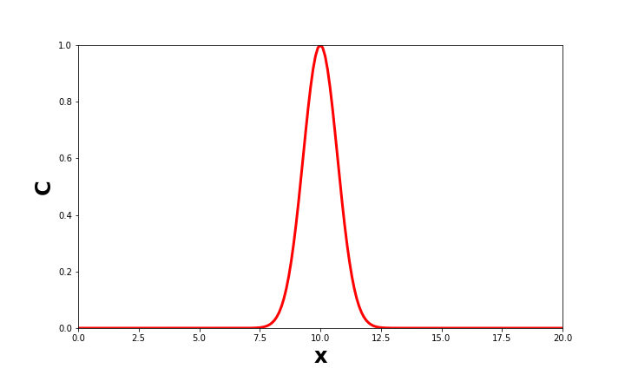
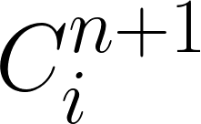
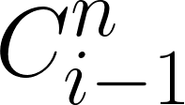
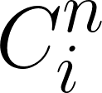
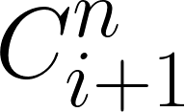
Solving PDEs by method of finite differences
Diffusion Equation:
Numerical Approximation:
Notes:
ODEs: Function of one variable and its derivatives (space OR time)
PDEs: Function of multiple variables and their derivatives (space AND time)
Only able to solve analytically in certain circumstances
Often resort to numerical approximations of solution
Finite Differences:
Numerical derivative given by (C at time n + 1) - (C at time n) / difference in time between n+1 and n.
Taking the limit as dt ⇒ 0, get true derivative
Can’t actually do this, so let dt become very small but still greater than zero.

Slide 3
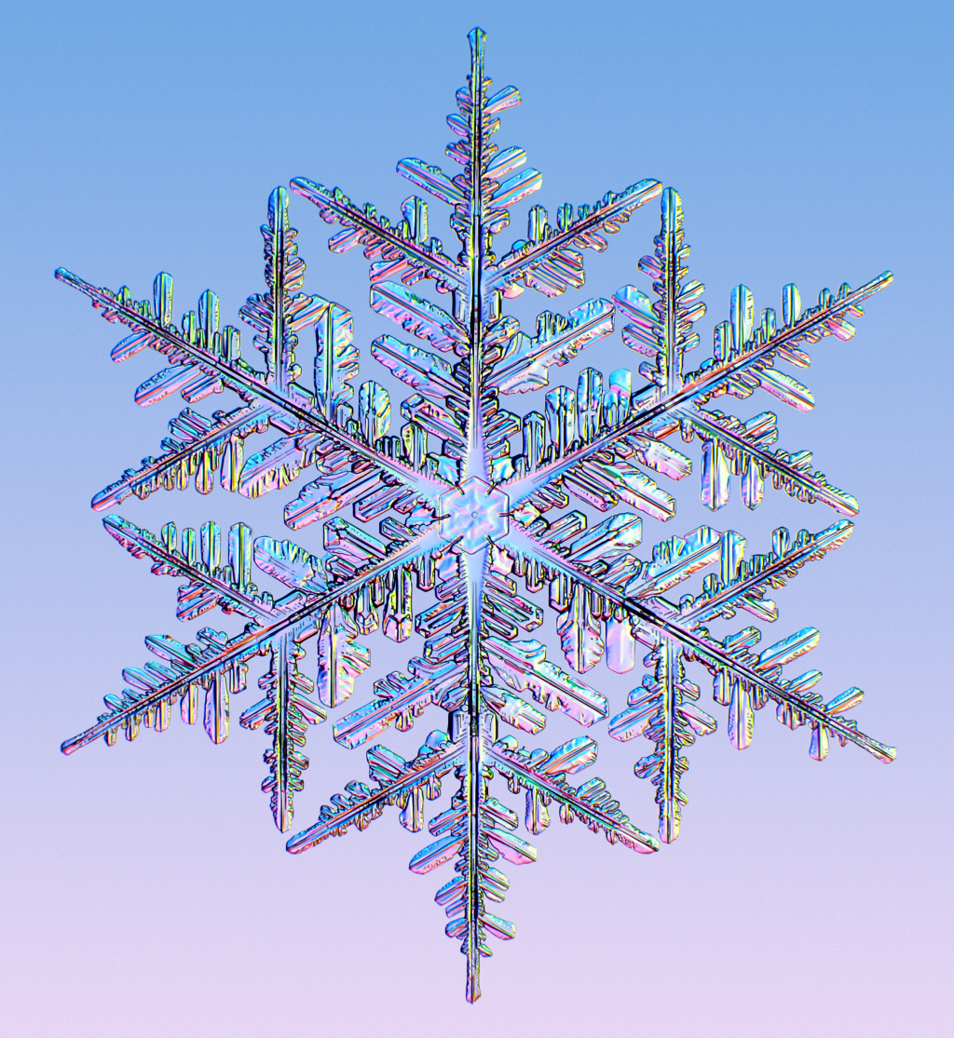
Many systems have complex boundary conditions
Many systems of interest can be described as two domains or phases separated by a thin interface.
Solidification, crystal growth, melting, vaporization, surface reaction and diffusion, etc.
Microstructural evolution in materials is often governed by interfacial phenomena
(Image courtesy of CalTech)
Notes:
Real world is described by PDEs.
We define the area governed by a given PDE as a domain.
Many systems of interest made up of more than one domain or phase. Liquid / Solid, Ordered / Disordered.
Interface between domains is where things are changing. Where melting / solidification / reaction is occurring.
Serves as boundary conditions of our PDEs. Important to properly describe in order to have accurate simulations.

Slide 4
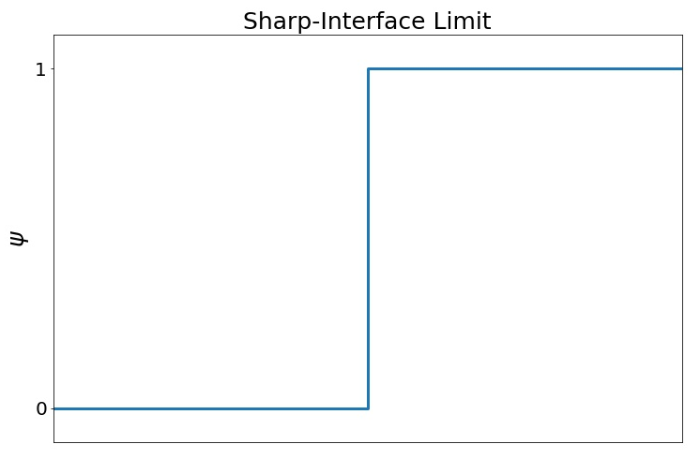
The challenge: simulating sharp interfaces
𝜓 = 0
𝜓 = 0 outside domain
𝜓 = 1 inside domain
𝜓 = 1
Notes:
Sharp-interface models describe phase as a binary state; things are either liquid or solid, black or white, separated by an infinitely thin interface.
Problem with these models is they are difficult to simulate numerically. Step function ⇒ not smooth or differentiable.
Have to explicitly track interface, computationally expensive and messy.

Slide 5
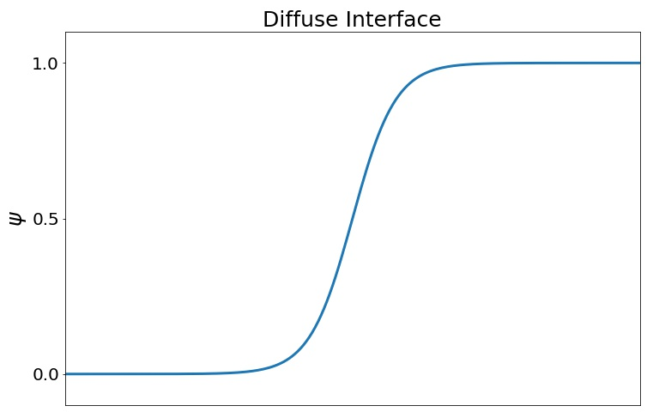
The solution: model interface as diffuse region
0 < 𝜓 < 1
0 < 𝜓 < 1 in interface
𝜓 = 0
𝜓 = 1
𝜓 = 0 outside domain
𝜓 = 1 inside domain
0.0
1.0
Notes:
Way we get around these problems is by modeling the interface as a diffuse region of finite thickness.
Unlike sharp interface models, our interface here is a smooth function. Rather than just black and white, we have a region where things are grey. Liquid and solid phases separated by region that is kind of both.

Slide 6
Diffuse interface models let us solve PDEs on boundaries of arbitrary geometry
Don’t have to explicitly track interface
Boundary conditions implicitly imposed by domain parameter 𝜓
Evolution of 𝜓 can itself be written as a PDE
Notes:
These models are very powerful since they allow us to describe our interface as a function itself. Domain parameter psi
We can incorporate the way that the interface changes and evolves in time into the PDEs describing our system.
This way, our boundary conditions are imposed implicitly by the domain parameter, without explicit tracking of interface.

Slide 7
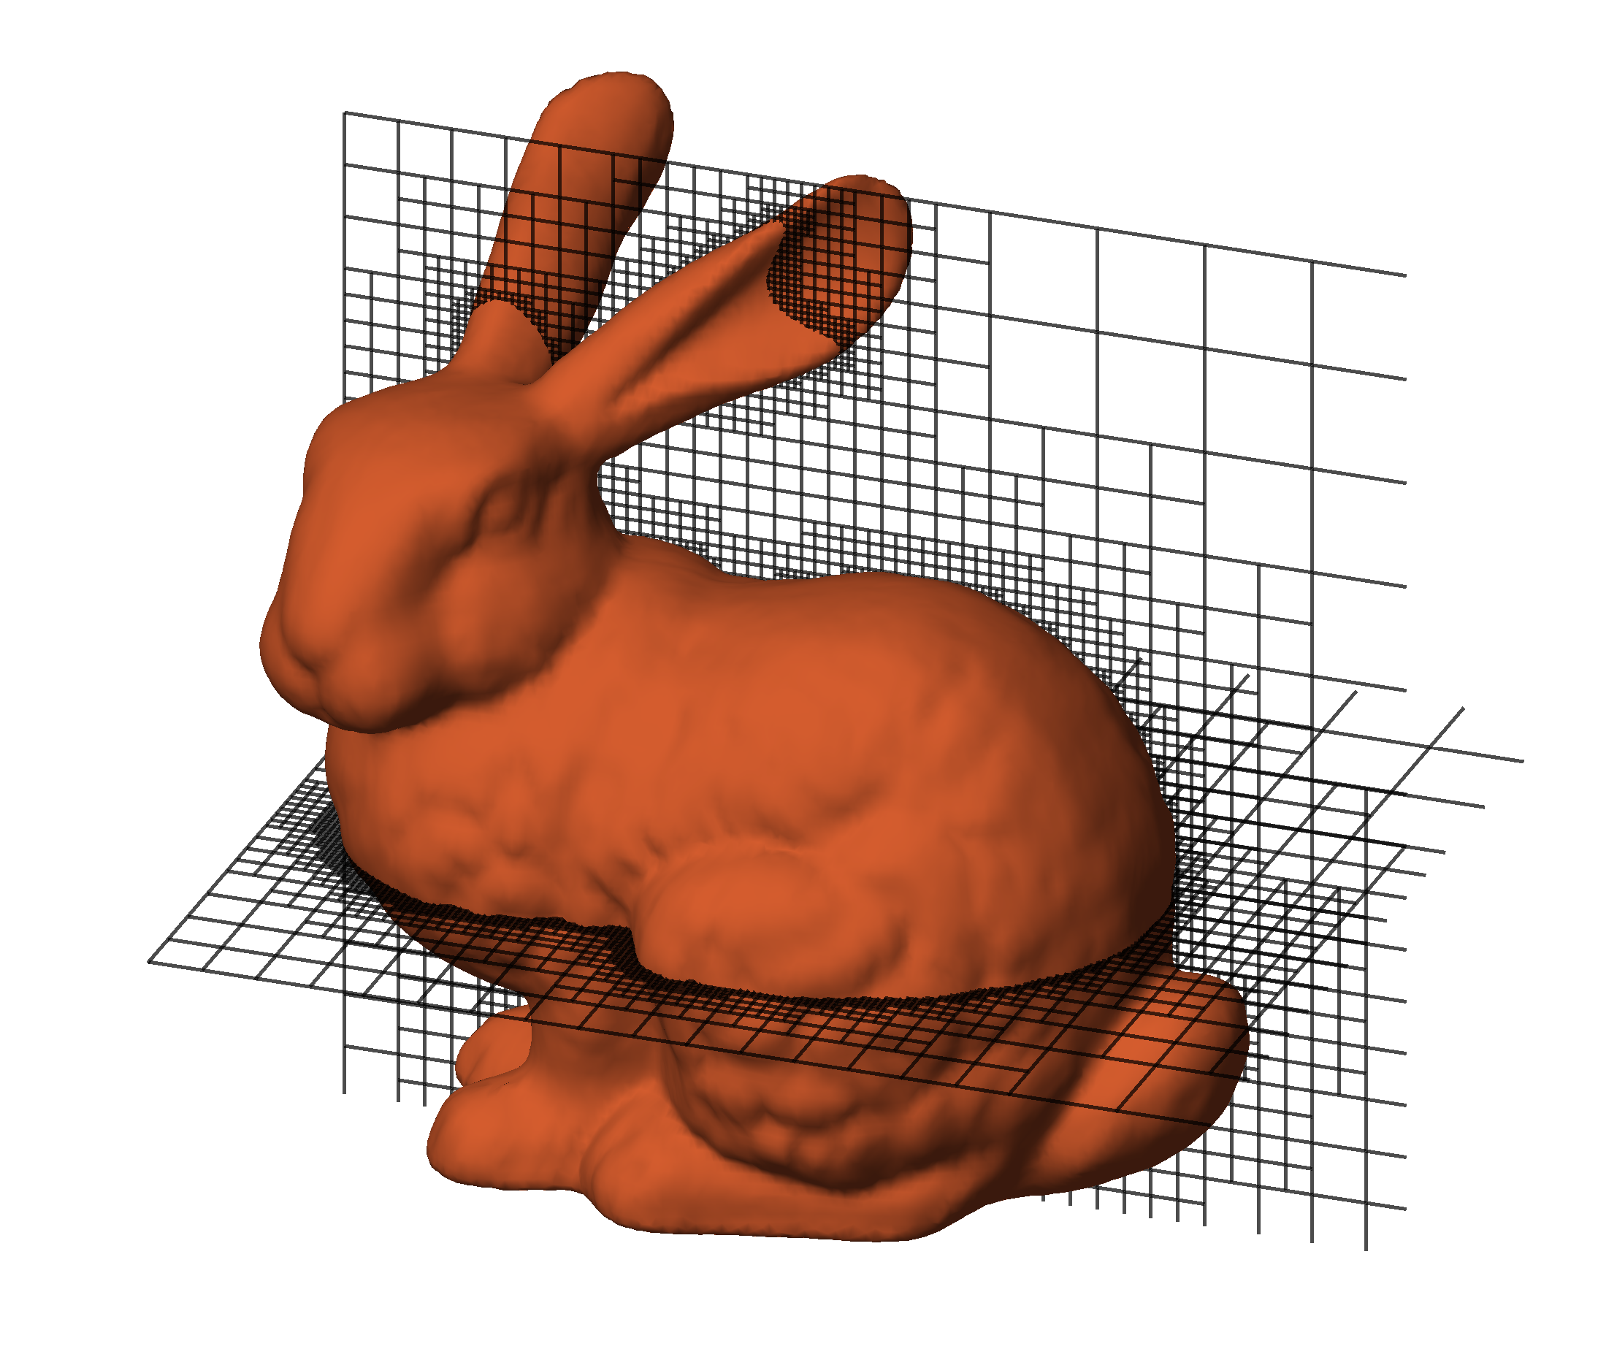
Applying AMR to the Smoothed Boundary Method
Allows us to effectively “shrink” the width of our interface relative to the length of our system by using finer grid spacing in interfacial regions
Preserves density of grid points across boundary
Can construct mesh from binary image or volume data, enabling numerical simulation of complex structures
Notes:
Conflicting length scales

Slide 8
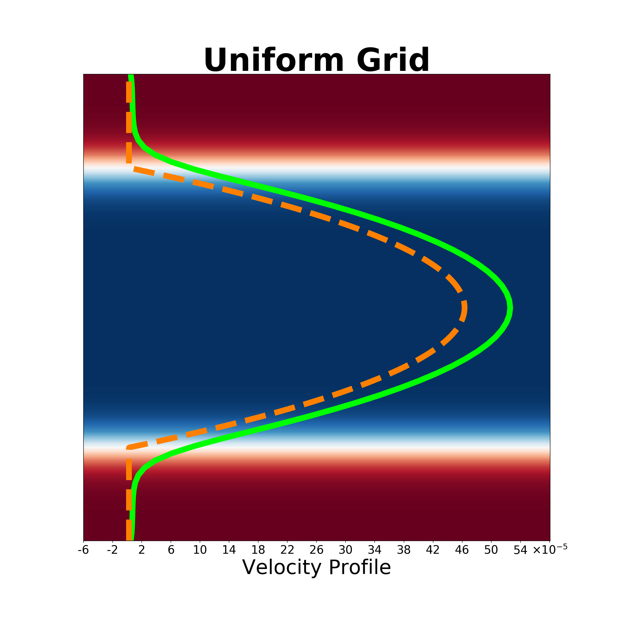
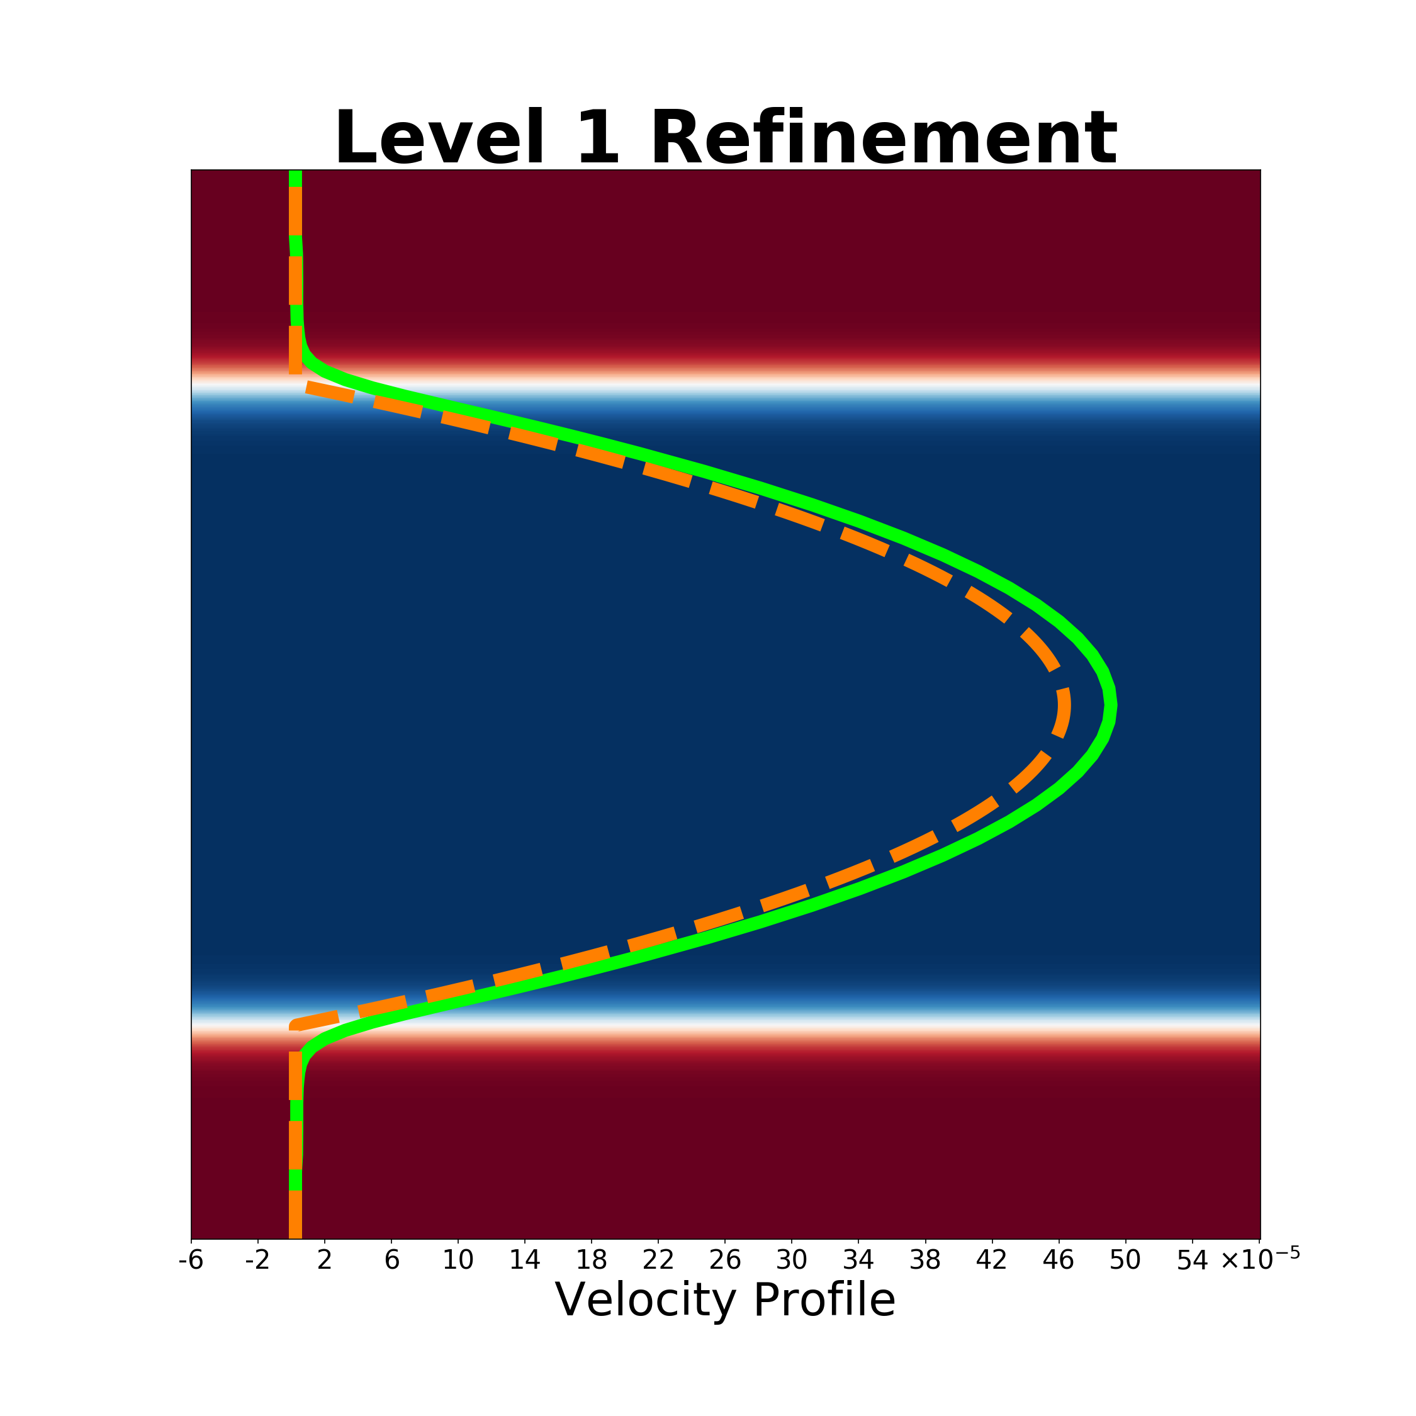
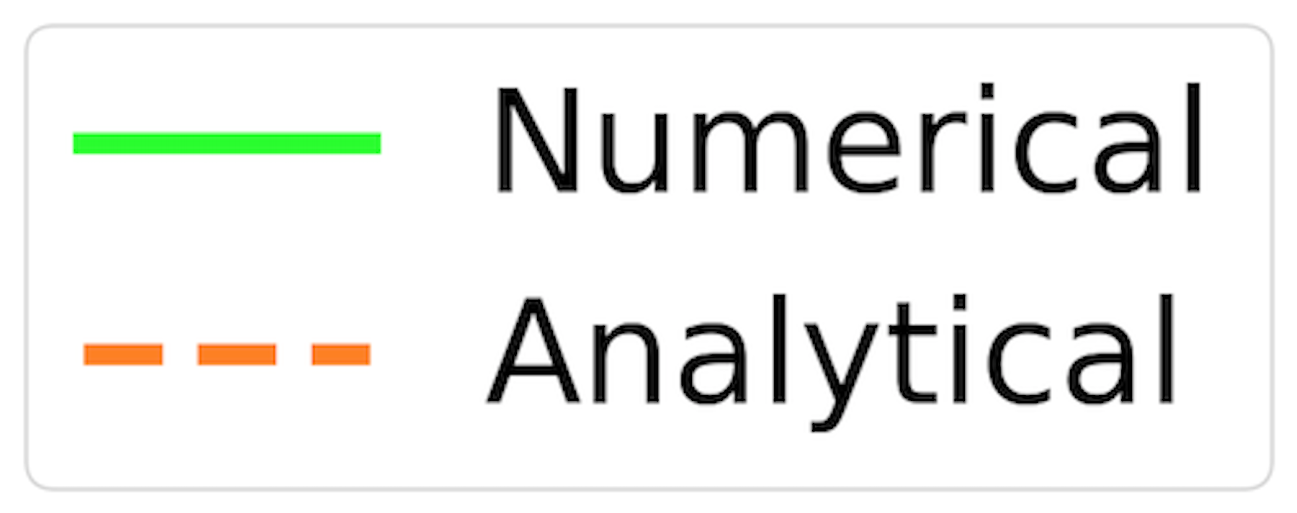
Accuracy Analysis: Simple Geometry
0.0 (Solid)
𝜓
1.0 (Liquid)

Slide 9
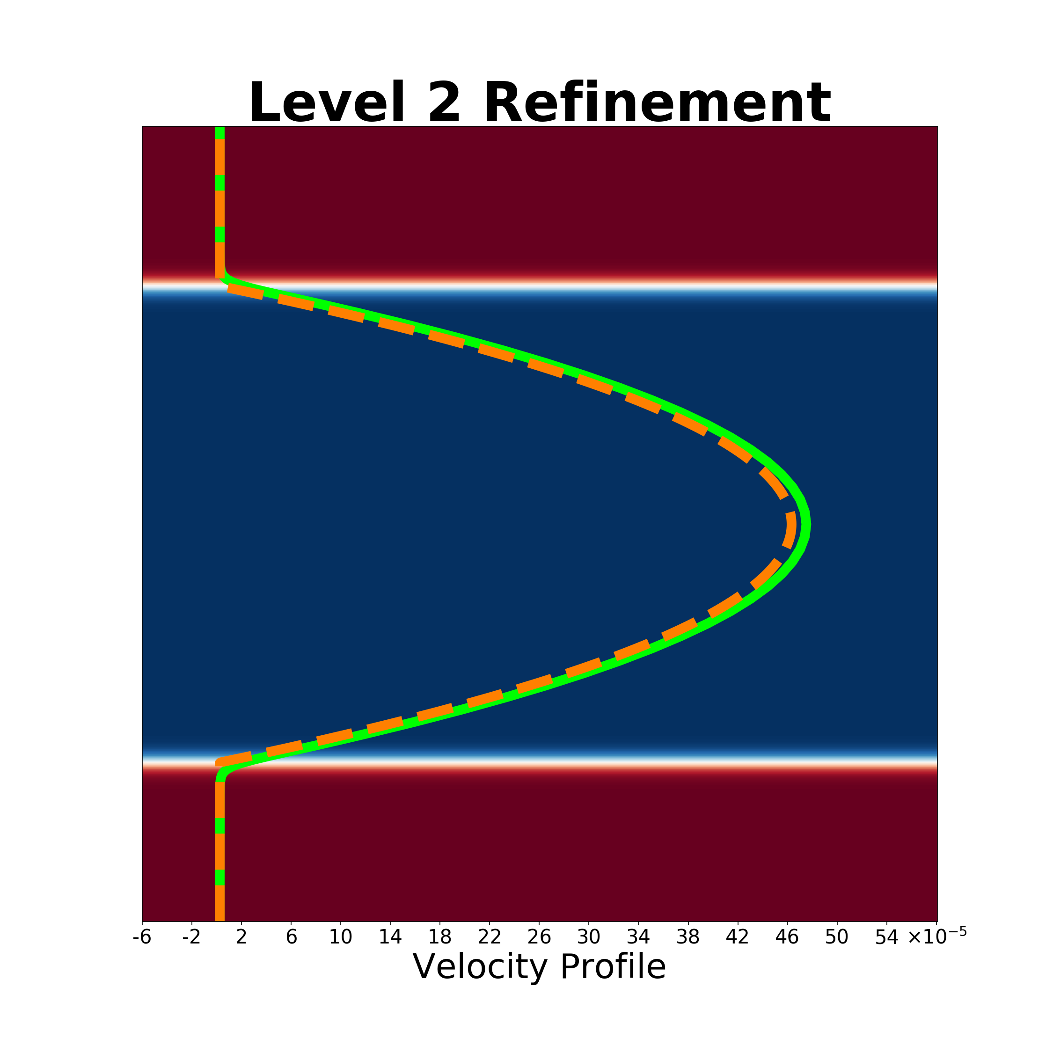
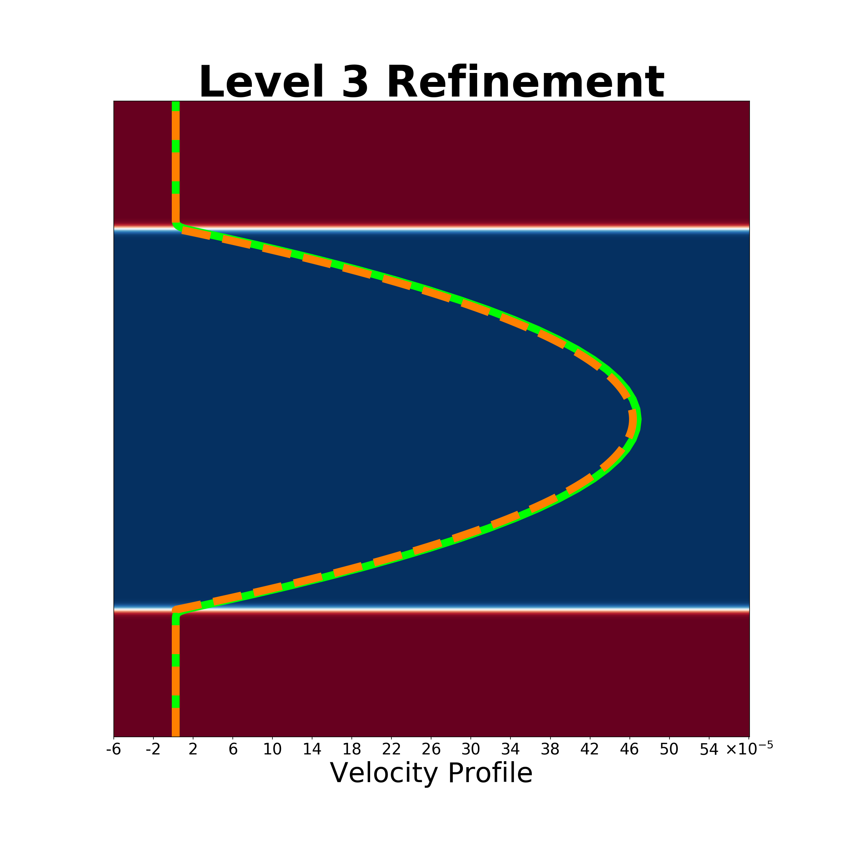
Accuracy Analysis: Continued
0.0 (Solid)
𝜓
1.0 (Liquid)

Slide 10
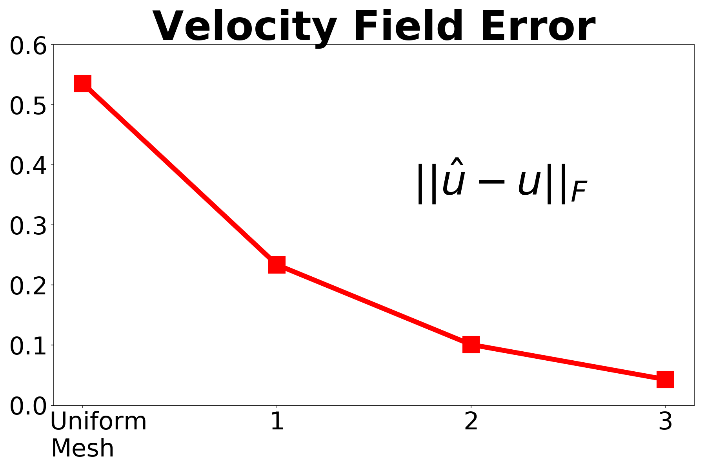
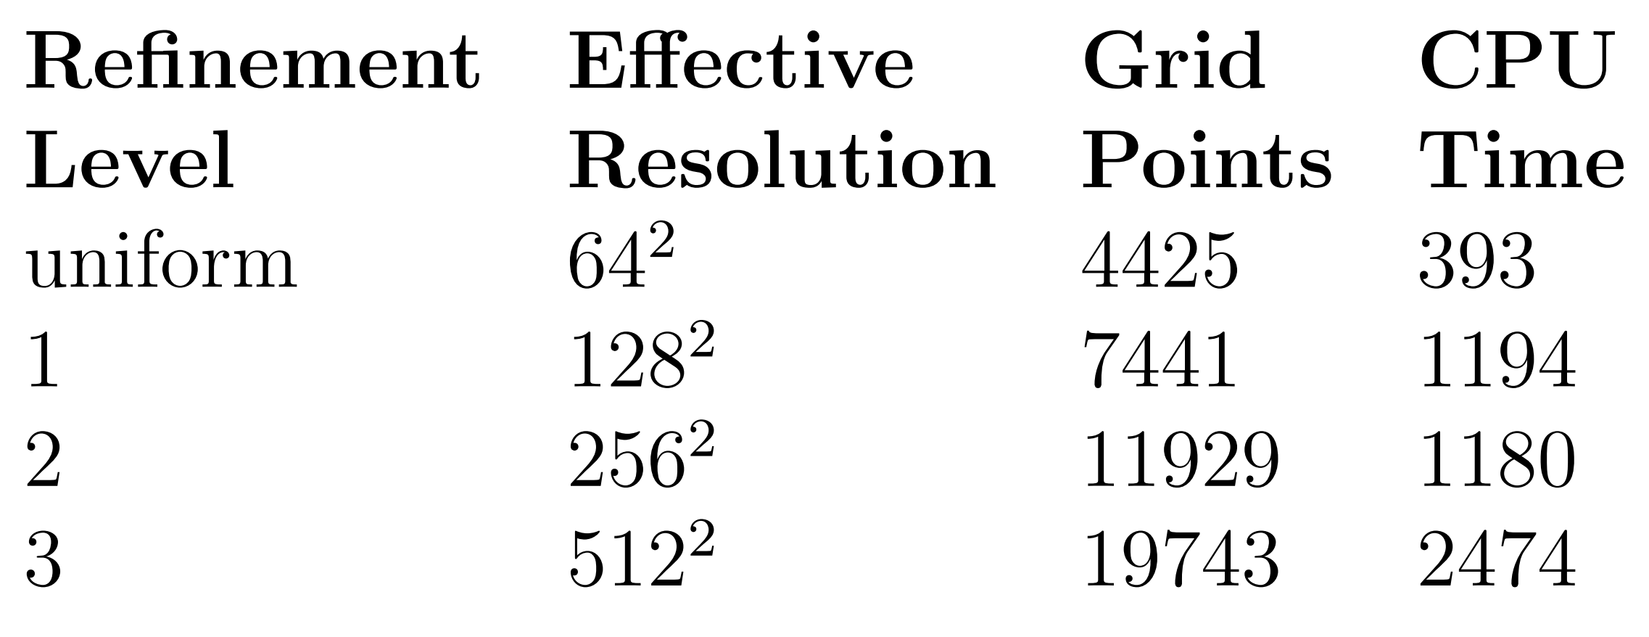
Accuracy Analysis: Continued
Notes:
Each time you refine the mesh, you reduce the width of your diffuse interface by one half, which corresponds to an equivalent reduction in error. On a uniform grid, this would require doubling the total number of grid points; however, with AMR, we are able to get away with far less, allowing us to have both accuracy and computational efficiency.

Slide 11
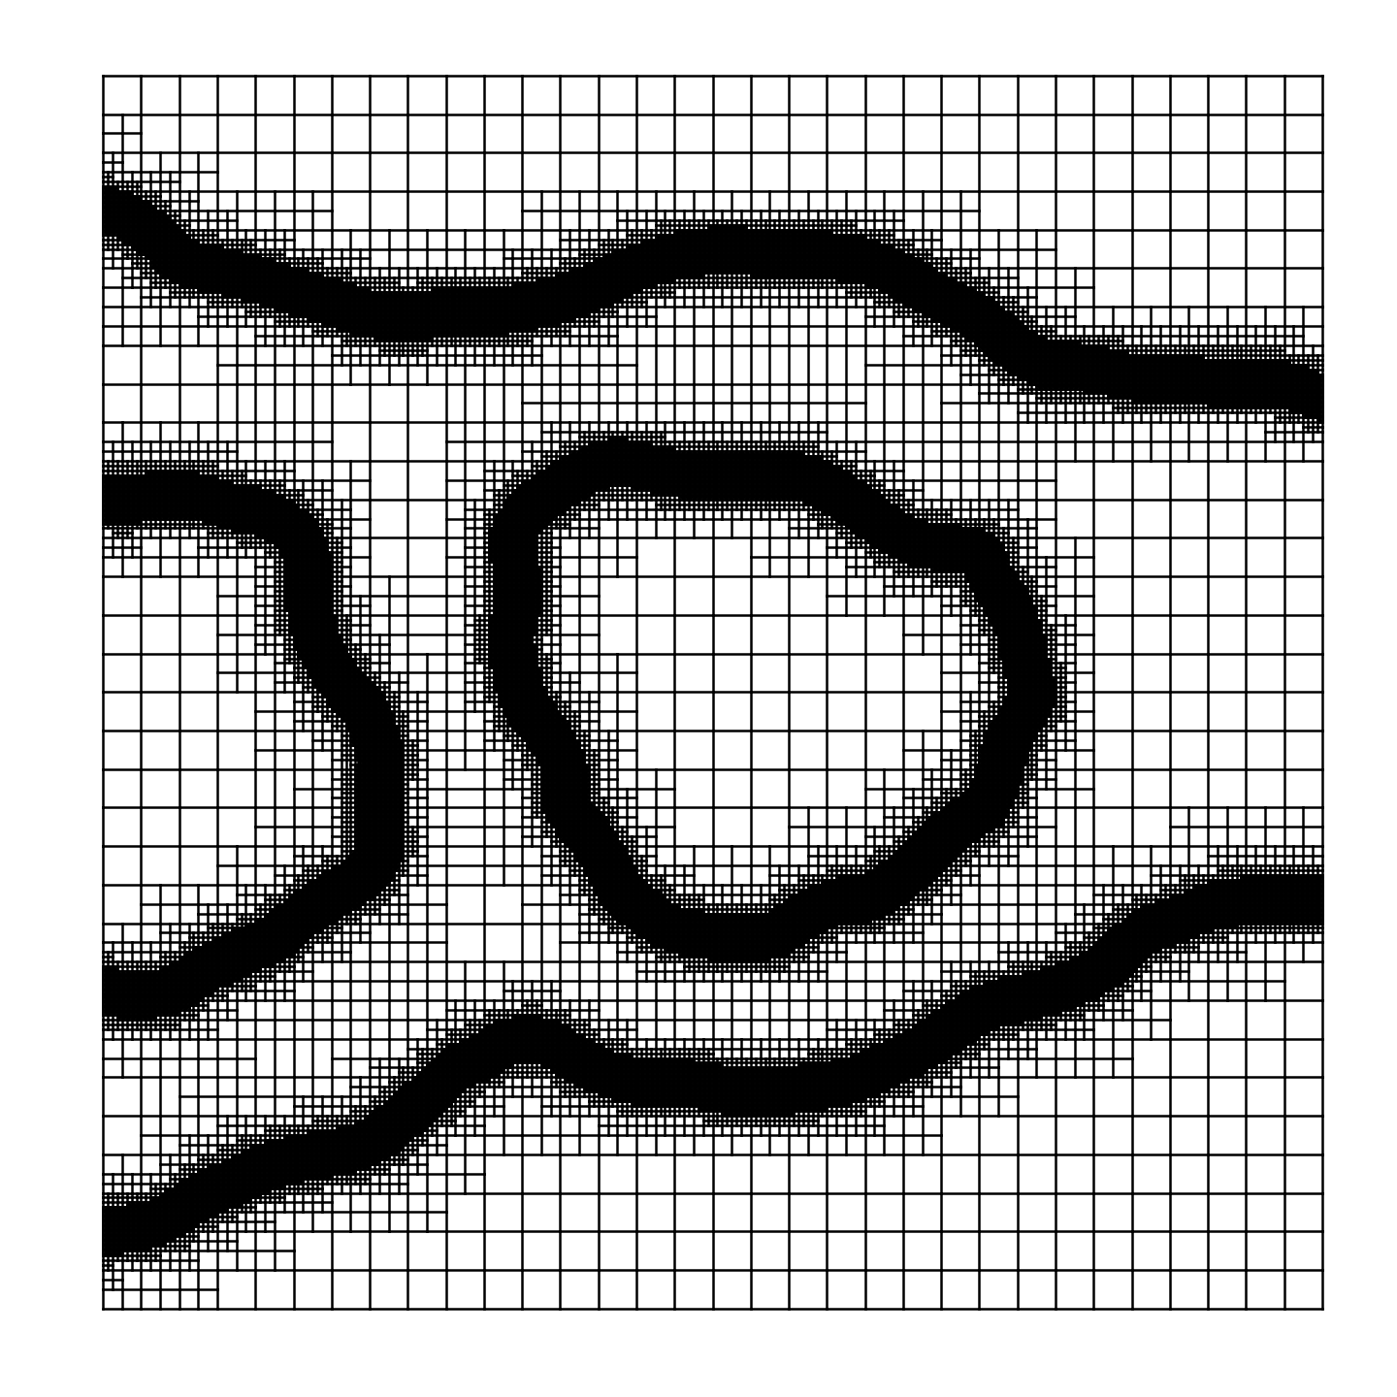
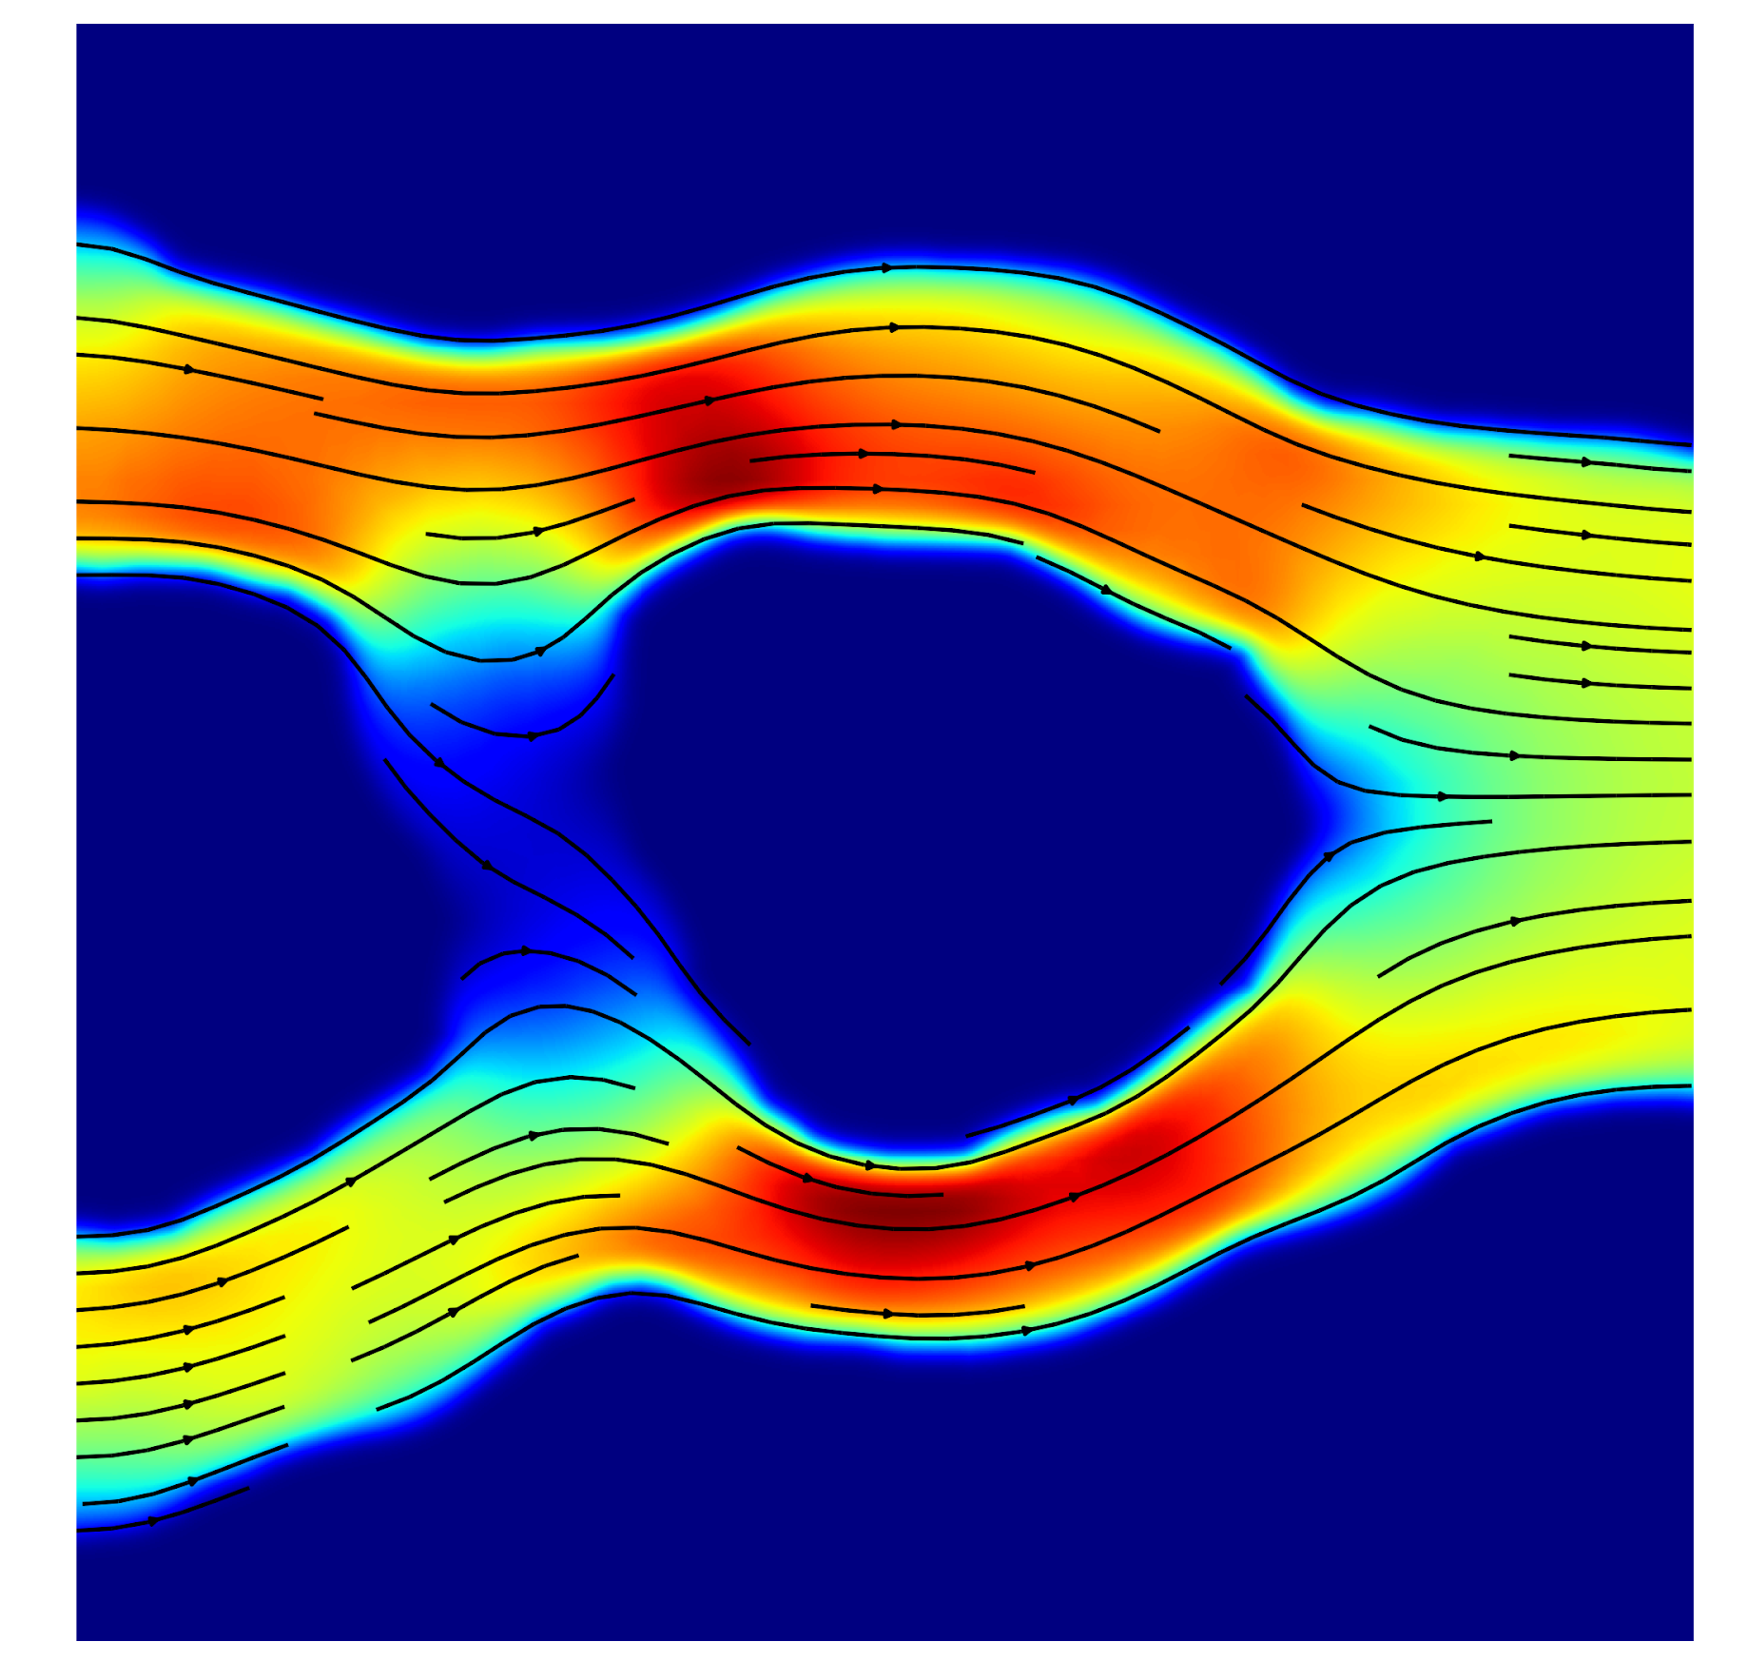
Applications: Fluid Flow in Complex Geometries

Slide 12
Thank you!

